Slide 1

How to Prepare a Request for Order to Modify Child Support, companion Spousal Support, Health Insurance Order, AND Custody/Visitation
(COMBO)
SUPERIOR COURT OF CALIFORNIA
COUNTY OF ORANGE
SELF-HELP CENTER/
FAMILY LAW FACILITATOR OFFICE

Slide 2
This document can assist you in completing the necessary paperwork for filing a Request for Order to Modify Child Custody, Visitation and Child Support.
It is recommended that you print a copy of this document first, then use the step-by-step instructions to complete the necessary forms.
You can then use the following links to go directly to the online version of the form, where you can type in the required information and then print the completed forms:
  Request for Order: http://www.courts.ca.gov/documents/fl300.pdf
  Child Custody and Visitation Attachment: http://www.courts.ca.gov/documents/fl311.pdf
  Income and Expense Declaration: http://www.courts.ca.gov/documents/fl150.pdf
  Declaration Regarding Address Verification: http://www.courts.ca.gov/documents/fl334.pdf
  Proof of Service by Mail: http://www.courts.ca.gov/documents/fl335.pdf
  Proof of Personal Service: http://www.courts.ca.gov/documents/fl330.pdf
Once you have completed and signed the appropriate forms, you can file them at the Lamoreaux Justice Center, Room 706 (on the 7th floor).
If you would like someone to review the documents before filing them, you can bring them to the Self-Help Center at the Lamoreaux Justice Center (on the first floor).

Slide 3
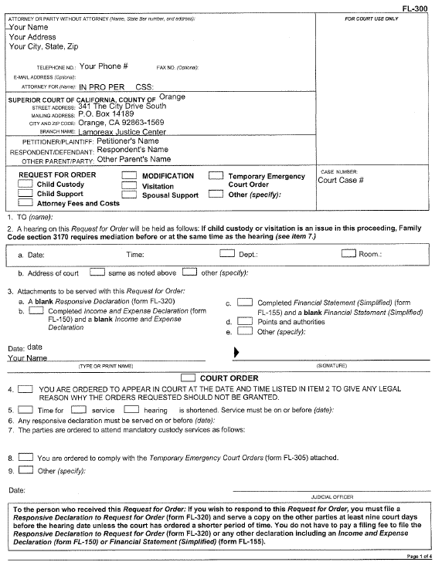
Request for Order
(page 1)
Enter your address and phone number here.

Slide 4
Request for Order
(page 1)
Enter “IN PRO PER” after “Attorney for:” This means you are self-represented (no attorney).
If Child Support Services is involved, enter your CSS case number here.

Slide 5
Request for Order
(page 1)
Enter this information (the Court’s Address) on the form.

Slide 6
Request for Order
(page 1)
Enter the Petitioner’s Name, Respondent’s name, and (if appropriate) the Other Parent’s name here.
Note: Use another filed document for this. The case caption does not change. If you are the Respondent named in the original filing document in the case, you will always be the Respondent, even if you are the one filing the Request for Order.

Slide 7
Request for Order
(page 1)
Enter the court case number here.

Slide 8
Request for Order
(page 1)
Check the boxes for Modification, Child Custody, Visitation, and Child Support.
If you are not requesting a change in Child Custody, do not check the Child Custody box.

Slide 9
Request for Order
(page 1)
Item 1. Enter the name(s) of the other party(ies). If CSS is involved in the case, “County of Orange” will be a party, together with the Other Parent’s name (and the words “and his/her attorney of record” if the other parent has an attorney)

Slide 10
Request for Order
(page 1)
Item 2. Do not enter anything here. When you file the document, the date, time and place of the hearing on the Request will be shown here (after it is filed).

Slide 11
Request for Order
(page 1)
Item 3. For a child support modification, check this box, as your Income and Expense Declaration needs to be attached.

Slide 12
Request for Order
(page 1)
Enter the date and your name, then sign the document here after it is printed.

Slide 13
Request for Order
(page 1)
Item 4. Check this box.

Slide 14
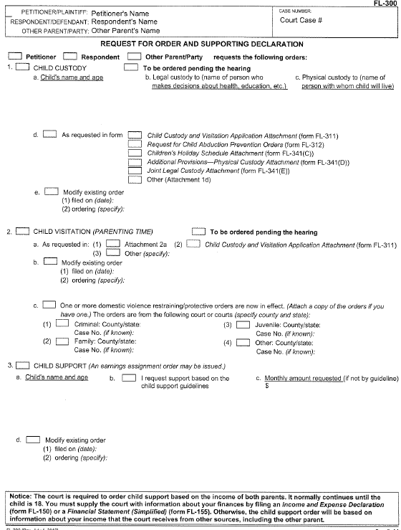
Request for Order
(page 2)
Check the box identifying the party filing the Request for Order.

Slide 15
Request for Order
(page 2)
Item 1.a, b, and c. If a change in custody is requested, check the Child Custody box, and enter the child(ren)’s name, age, and the party or parties who will have Legal and/or Physical custody.

Slide 16
Request for Order
(page 2)
Item 1.d. Check the “As Requested in form,” and “Child Custody and Visitation Application” boxes.

Slide 17
Request for Order
(page 2)
Item 1.e. If there is an existing order, check this box, and enter the date and terms of the order here.

Slide 18
Request for Order
(page 2)
Item 2.a. If (a change in) visitation is being requested, check this box, and the box for “(2) Child Custody and Visitation Application Attachment.”

Slide 19
Request for Order
(page 2)
Item 2.b. If there is an existing visitation order, check this box and enter the date and terms of the order here.
Item 2.c. Use this section if there are any domestic violence restraining orders or protective orders now in effect. Check the appropriate box and provide the case number, if known.

Slide 20
Request for Order
(page 2)
Item 3. Check the box for Child Support.

Slide 21
Request for Order
(page 2)
Item 3.1, b, and c. Enter the child(ren)’s name and age, and the amount requested (check guideline if that is what is being requested).

Slide 22
Request for Order
(page 2)
Item 3.d. If there is previous order, enter the date and terms here.

Slide 23
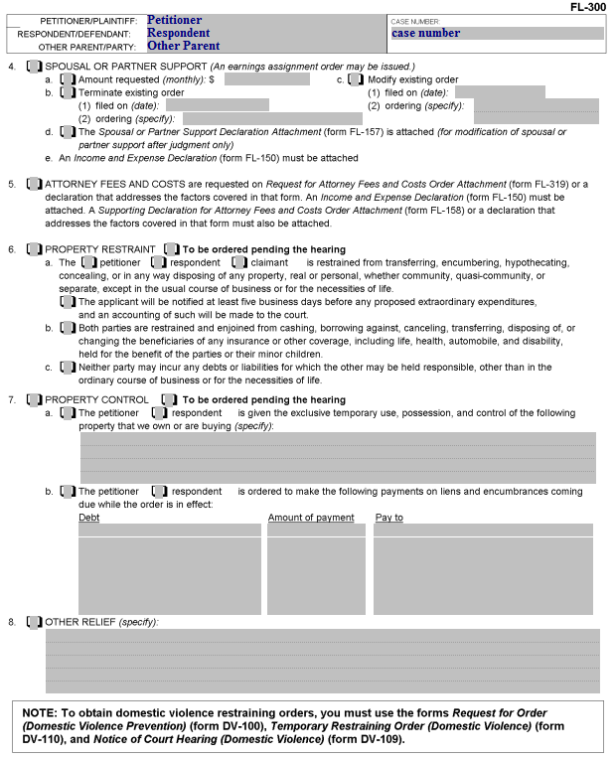
Request for Order
(page 3)
Item 8. If other relief is requested, check this box and enter the other relief being requested.

Slide 24
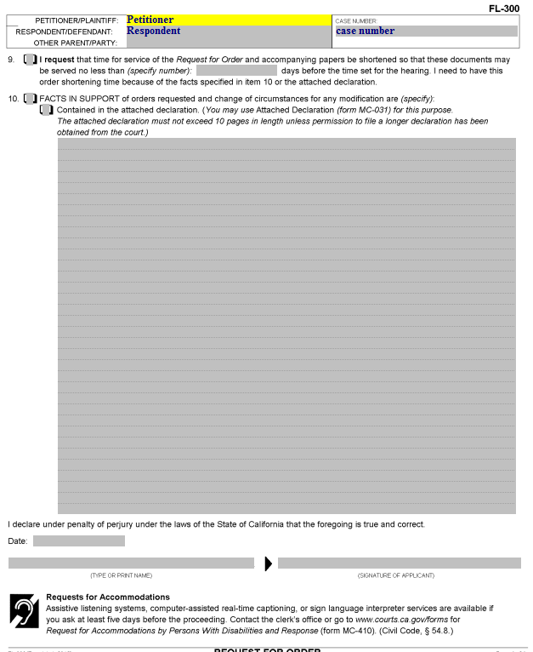
Request for Order
(page 4)
Item 10. Check the box for this item. Facts supporting the request can be written here or on a separate declaration page. If you use a separate declaration page, check the box for “Contained in the attached declaration.”

Slide 25
Request for Order
(page 4)
Enter the date, your printed name and your signature here.

Slide 26
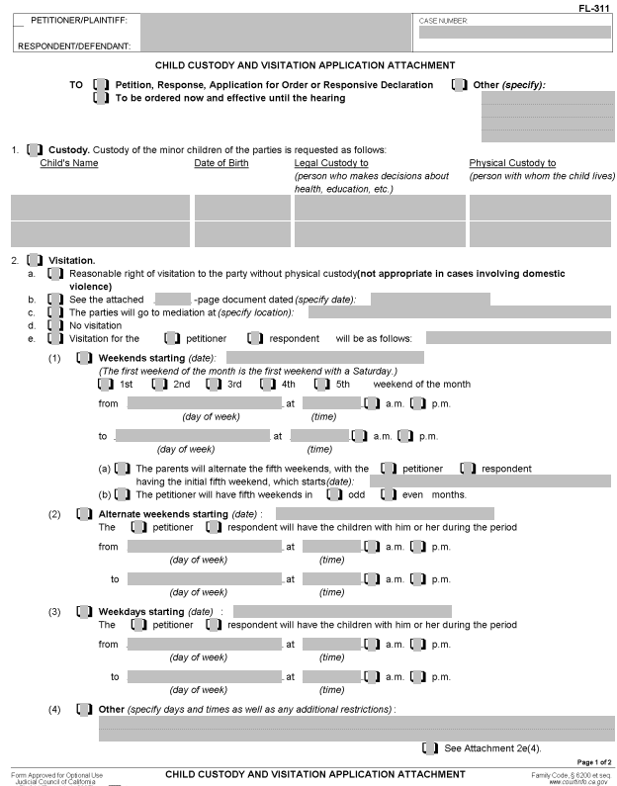
Child Custody and Visitation Attachment
(page 1)
Enter the Petitioner, Respondent and Case Number here.
Note: This should be the same as the Request for Order.

Slide 27
Child Custody and Visitation Attachment
(page 1)
Check this box and enter “Request for Order” here.

Slide 28
Child Custody and Visitation Attachment
(page 1)
Item 1. If child custody is being sought (either for new orders or to change the current order), check this box and enter the child(ren)’s name(s), birth date(s), and the Name(s) of the person(s) who will have legal and/or physical custody.

Slide 29
Child Custody and Visitation Attachment
Item 2. Check this box if you are requesting visitation or a change in visitation.

Slide 30
Child Custody and Visitation Attachment
Item 2.a. Check this box if you want an order for “Reasonable” visitation. If you do so, and the other party does not respond, the resulting order will not provide any specific day(s) or time(s) for the visitation.

Slide 31
Child Custody and Visitation Attachment
Item 2.c. Regardless of your choices, you will be required to go to mediation at the Lamoreaux Justice Center (LJC). Check this box and ad “LJC” at the end of this line.
Remember, if the other party does not respond, you will likely receive exactly what you request on this page.

Slide 32
Child Custody and Visitation Attachment
Item 2.d. If you do not want the other party to have visitation, check this box.

Slide 33
Child Custody and Visitation Attachment
Item 2.e. To specify the visitation to be granted to either you or the other party, check the appropriate box (see the case caption at the top of the page to see which is which).

Slide 34
Child Custody and Visitation Attachment
Remember, if the other party does not respond, your order will most likely be for what you are requesting in terms of visitation.
Check the appropriate box(es) and enter the day and time for the visitation to begin and end. If you use the “Weekends” section, check the box for the weekend(s) you are requesting visitation for.
If your desired visitation does not ‘fit’ on of the sections, check the box for “Other” and write in what you want.

Slide 35
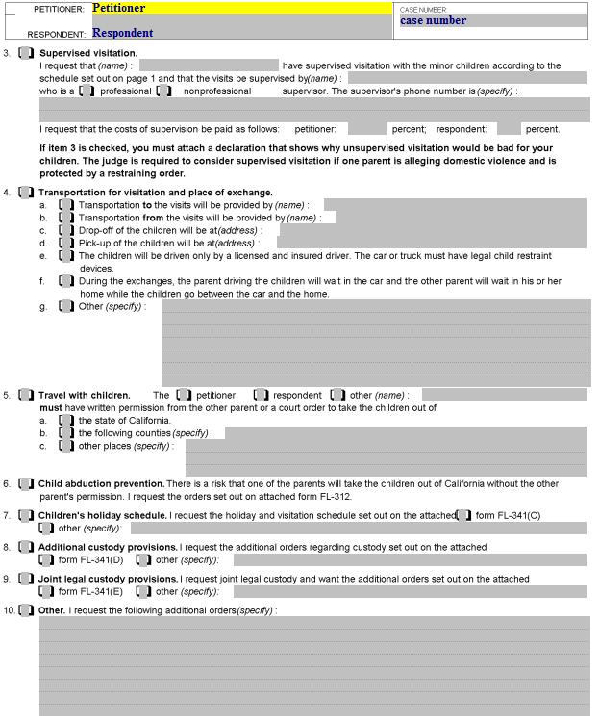
Child Custody and Visitation Attachment (page 2)
Item 3. This section is used if you want to require that visitation be supervised, in which case you will need to complete all items in this section, including attaching the required declaration.

Slide 36
Child Custody and Visitation Attachment (page 2)
Item 4. This section is used if you want to specify any of these items regarding transportation for visitation and the place of exchange.
  For example, if you want the children to be driven only by a licensed and insured driver, check the box for “4.” and “e.”

Slide 37
Child Custody and Visitation Attachment (page 2)
Item 5. This section is used if you want to have any travel restrictions.
  For example, if you do not want the other party to be able to take the children outside of the State of California without your written permission or a court order, check “5” and also “a.”

Slide 38
Child Custody and Visitation Attachment (page 2)
Items 6 – 9. Check the box for these sections if they apply to your case, and complete the designated form for each box you check.

Slide 39
Child Custody and Visitation Attachment (page 2)
Item 10. Check this box if you are requesting any other orders regarding custody and/or visitation, and state what you are asking for.

Slide 40
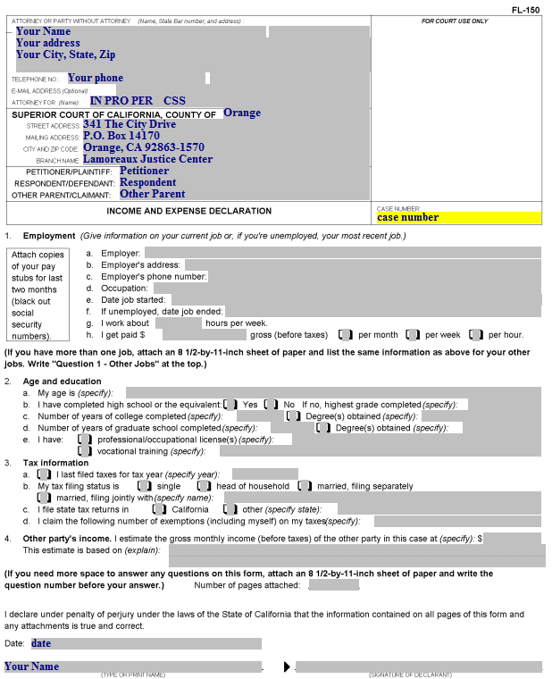
Income and Expense Declaration
Enter your name, address, phone number, and the words “IN PRO PER” on the “Attorney For” line.
If the Dept. of Child Support Services is involved in your case, enter your CSS case number after the “IN PRO PER”

Slide 41
Income and Expense Declaration
Enter the Petitioner’s name, the Respondent’s name, and (if applicable) the Other Parent’s name here.

Slide 42
Income and Expense Declaration
Enter the court case number here.

Slide 43
Income and Expense Declaration
Item 1.a. If you are employed, enter your employer’s name here (do not fill this section out if you are self-employed).
If you are unemployed, enter the name of your last employer, followed by:
“unemployed”.
If you are self-employed, enter “Self employed” and provide information about your self-employment on page 2, item 7.

Slide 44
Income and Expense Declaration
Item 1.b. Enter the address of the employer from 1.a.

Slide 45
Income and Expense Declaration
Item 1.c. Enter the phone number of the employer from 1.a.

Slide 46
Income and Expense Declaration
Item 1.d. Enter your occupation/job title here.

Slide 47
Income and Expense Declaration
Item 1.e. Enter the date you started this job.

Slide 48
Income and Expense Declaration
Item 1.f. If you are unemployed, enter the date your last job ended here.

Slide 49
Income and Expense Declaration
Item 1.g. Enter the average number of hours you work per week.

Slide 50
Income and Expense Declaration
Item 1.h. If you are paid an hourly wage, enter it and check the “per hour” box. If you are paid a weekly or monthly salary, enter the gross amount (before deductions) you are paid and check the appropriate box.

Slide 51
Income and Expense Declaration
Item 2. Enter the following:
Item 2.1. Your age
Item 2.b. If you have completed high school (or the equivalent, such as GED), and if not, the highest grade you completed.
Item 2.c. The number of years of college completed and any degrees
Item 2.d. Graduate school information
Item 2.e. Professional/occupational licenses and/or vocational training.

Slide 52
Income and Expense Declaration
Item 3. Enter the following:
3.a. The last year for which you filed your income taxes (e.g., if you filed in 2012, it was for the year 2011).
3.b. Your tax filing status for the current year.
3.c. If you live in California, check the box for “California.” If not, check “other” and enter the state where you will file taxes for this year.
3.d. If you are single, your exemptions will be one. If you are married or head of household, your exemptions will be yourself and your spouse and the children living with you.

Slide 53
Income and Expense Declaration
Item 4. Here you provide:
The other party’s income.
Unless you know the party’s income, enter “unknown.” if you put an amount in this item, you then have to state how you know that amount.

Slide 54
Income and Expense Declaration
Enter the date and your name, then sign this page after it is printed.

Slide 55
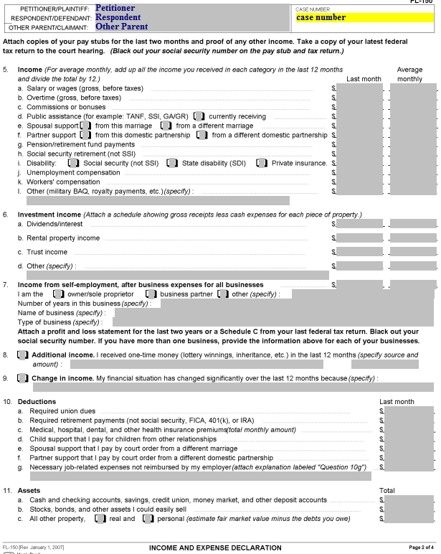
Income and Expense Declaration (page 2)
Item 5. This column labeled “Last Month: is for your income received during the preceding month (e.g., if it’s June 14, you would put in May’s information) The column labeled “Average Monthly” is for your average income per month over the last 12 months.
If your income for any of the line items has remained the same, the numbers in both columns would be the same.
If you did not have this income for all 12 months, divide the total income you received for the last 12 months by 12 to determine the average monthly income.

Slide 56
Income and Expense Declaration (page 2)
Item 5.a. Enter your salary or wages earned, before any deductions here.

Slide 57
Income and Expense Declaration (page 2)
Item 5.b and c. Enter the amount for any overtime, commissions or bonuses you received in addition to the amount for line 5.a. here.

Slide 58
Income and Expense Declaration (page 2)
Item 5.d. Enter the amount you receive for any public assistance you receive, including food stamps. If you are currently receiving the aid, check the “currently receiving” box.

Slide 59
Income and Expense Declaration (page 2)
Item 5.e. Enter the amount you are receiving for spousal support from this marriage or a different marriage here.
Item 5.f. Same as 5.e., but for domestic partnerships.

Slide 60
Income and Expense Declaration (page 2)
Item 5.g. Enter the amount you are receiving for any pension or retirement fund payments.
Item 5.h. Enter the amount you are receiving for Social Security retirement.

Slide 61
Income and Expense Declaration (page 2)
Item 5.i. Enter the amount you are receiving (before deductions) for disability. Check the appropriate box for the type of disability you are receiving.

Slide 62
Income and Expense Declaration (page 2)
Item 5.j. Enter the amount you are receiving (before deductions) for unemployment compensation.

Slide 63
Income and Expense Declaration (page 2)
Item 5.k. Enter the amount you are receiving (before deductions) for worker’s compensation.

Slide 64
Income and Expense Declaration (page 2)
Item 5.k. Enter the amount you are receiving (before deductions) for other types of compensation.

Slide 65
Income and Expense Declaration (page 2)
Item 6. Enter the amount(s) you are receiving for Dividend/interest income, Rental property income (which would include renting out rooms in your house), trust income or any other sources of income, using the same “Last month” and “Average monthly” columns.

Slide 66
Income and Expense Declaration (page 2)
Item 7. This section is for Income from self-employment, AFTER business expenses.
The same two columns apply.
Check the box for the type of self-employment income. An example of “other” would be “Independent Contractor.”
Provide the information for the number of years you’ve been in the business, the name of the business and the type of business.
You MUST have a profit and loss statement for the past 2 years or a Schedule C. If you don’t attach it, you must bring it to the hearing.

Slide 67
Income and Expense Declaration (page 2)
Item 8. If you have one-time income from any other sources in the past 12 months, it should be listed here.

Slide 68
Income and Expense Declaration (page 2)
Item 9. Note any change in income over the past 12 months here. This is especially important if you have just become unemployed, and you are reporting last month’s income from your previous job.

Slide 69
Income and Expense Declaration (page 2)
Item 10. Deductions:
Item 10.a. Required union dues.

Slide 70
Income and Expense Declaration (page 2)
Item 10. Deductions:
Item 10.b. Required retirement (usually if you are employed by a public agency). This would not include contributions to a 401(k) account.

Slide 71
Income and Expense Declaration (page 2)
Item 10. Deductions:
Item 10.c The cost to you for health insurance premiums (health, dental, vision). Do not include amounts paid by your employer.

Slide 72
Income and Expense Declaration (page 2)
Item 10. Deductions:
Item 10.d. Child support you pay for children from OTHER relationships (not those in this case) .

Slide 73
Income and Expense Declaration (page 2)
Item 10. Deductions:
Item 10.e. Spousal support for a different marriage

Slide 74
Income and Expense Declaration (page 2)
Item 10. Deductions:
Item 10.f. Partner support that you pay by court order from a different domestic partnership.

Slide 75
Income and Expense Declaration (page 2)
Item 10. Deductions:
Item 10.g. Enter the monthly amount you pay for necessary job-related expenses that are not reimbursed by your employer. For example, uniforms.
Enter a description of these expenses on the line under 10.g. If you need more room, attach a written explanation labeled “Question 10g.”

Slide 76
Income and Expense Declaration (page 2)
Item 11. Assets:
Item 11.a. Enter the amount of cash in your pocket/purse, in a bank or other financial institution account.

Slide 77
Income and Expense Declaration (page 2)
Item 11. Assets:
Item 11.b. Stocks & bonds. Enter the value of any stocks, bonds, or other similar assets you could easily sell.

Slide 78
Income and Expense Declaration (page 2)
Item 11. Assets:
Item 11.c.
If you own your home, check the “real” property box and calculate your equity (current value minus what you still owe on your mortgage)
If you own a car, check the “personal” property box and calculate your equity (current value minus what you still owe)
Put the sum of the real and personal property in the “Total” column.

Slide 79
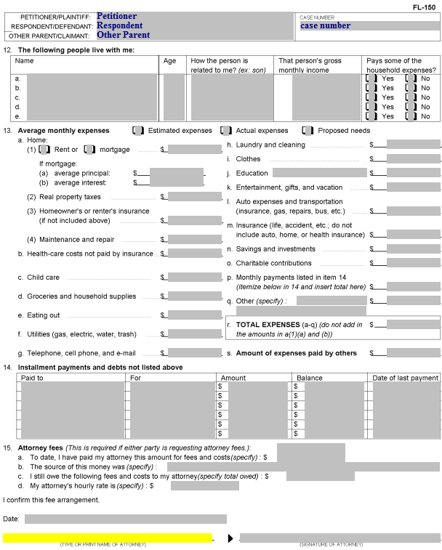
Income and Expense Declaration (page 3)
Item 12. People living with you:
Don’t include yourself.
Don’t include “roommates” (and don’t include their portion of the expenses).
Include the name(s), age(s), relationship to you, income (if known – otherwise “unknown”) and whether the person contributes to household expenses.
Distinguish between biological children and stepchildren.

Slide 80
Income and Expense Declaration (page 3)
Item 13. Check whether the expenses you are describing are Estimated, Actual or Proposed.
In most cases, check “estimated” unless you have proof of your “actual” expenses.
You can use “Proposed” expenses if you want to show what you will need in the future (e.g., you need to move out with a child).

Slide 81
Income and Expense Declaration (page 3)
Item 13.1. Home:
Item 13.a.(1) Check whether you rent or are paying a mortgage, and put the amount you pay each month.
If you know your average principal and interest on your mortgage, enter this information in (a) and (b).
Do not include the average principal and average interest in the Total Expenses.

Slide 82
Income and Expense Declaration (page 3)
Item 13.a(2) Enter your real property taxes if they are separate from your mortgage payment.

Slide 83
Income and Expense Declaration (page 3)
Item 13.a(3) Enter your homeowner’s insurance (if not included in the mortgage payment) or renter’s insurance.

Slide 84
Income and Expense Declaration (page 3)
Item 13.a(4) Enter the monthly average you pay for maintenance and repairs on your home.

Slide 85
Income and Expense Declaration (page 3)
Item 13.b. Enter your health care costs NOT covered by health insurance
This would include out-of-pocket costs for Doctor visits, emergency room visits, co-pays, prescription costs, etc.

Slide 86
Income and Expense Declaration (page 3)
Item 13.c. Enter the costs paid by you for child care for children in your household. Do not enter child care paid by you to the other parent as part of a court order in this case.

Slide 87
Income and Expense Declaration (page 3)
Item 13.d. Enter your average monthly costs for groceries and household supplies (what you would buy at the supermarket and/or drug store).

Slide 88
Income and Expense Declaration (page 3)
Item 13.e. Enter your average monthly cost for eating out. This includes taking the family out to dinner as well as your costs for lunches (if you go somewhere for lunch during your lunch break).

Slide 89
Income and Expense Declaration (page 3)
Item 13.f. Enter your average monthly utility (gas, electric, water/sewer, trash) costs. (Gas is for home gas service, not gasoline for your car).

Slide 90
Income and Expense Declaration (page 3)
Item 13.g. Enter your average monthly costs for telephone, cell phone, and e-mail (i.e., internet/cable)

Slide 91
Income and Expense Declaration (page 3)
Item 13.h. Enter your costs for laundry and cleaning.
This would include costs of doing your laundry at a Laundromat, or the costs of taking clothes to the cleaners/dry cleaners
If you do your laundry at home, the cost of laundry soap, etc. should be included in the “Groceries and household supplies” line item (13.d).

Slide 92
Income and Expense Declaration (page 3)
Item 13.i. Enter your average monthly cost for clothes, for you and your household members.
If there are school-age children, don’t forget to include the amounts you spend for “back-to-school” clothes. Take the amount you spend annually and divide it by 12.

Slide 93
Income and Expense Declaration (page 3)
Item 13.j. Enter your average monthly cost for education.
This could be education costs for you or any member of your household, including children/stepchildren.

Slide 94
Income and Expense Declaration (page 3)
Item 13.k. Enter your monthly costs for entertainment, gifts, and vacations.
You can include birthday gifts, outings with children, and other items here. (Divide the annual cost by 12 for an average monthly amount)

Slide 95
Income and Expense Declaration (page 3)
Item 13.l. Enter your average monthly cost for car insurance, gas and repairs, or your bus or other transportation costs.
Your monthly car payment should NOT be included here (it will go in item 14).

Slide 96
Income and Expense Declaration (page 3)
Item 13.m. Enter the cost of your life or accident insurance.
Your home, automobile, or health insurance is included in other items, not here.

Slide 97
Income and Expense Declaration (page 3)
Item 13.n. If you make regular contributions to savings/investments, enter the average monthly amount.

Slide 98
Income and Expense Declaration (page 3)
Item 13.o. Enter your average monthly amount for charitable contributions (e.g., church offering).
Remember, if you make a weekly contribution, multiply the weekly amount by 52 and then divide by 12 (there are more than 4 weeks in some months).

Slide 99
Income and Expense Declaration (page 3)
Item 13.p. Enter the sum of the “Amount” column in Item 14 here (go to next slide).

Slide 100
Income and Expense Declaration (page 3)
Item 14. You will enter information about any monthly installment payments you are making here.
This would include your car payment, loans on which you are making monthly payments (e.g., personal loans, student loans), credit cards, or store accounts.
If you have more items than will fit in the space provided, attach an additional page labeled “Item 14” and provide the same information for each additional item.

Slide 101
Income and Expense Declaration (page 3)
Here you list who you make your monthly payment to.

Slide 102
Income and Expense Declaration (page 3)
Here you list what the payment is for (e.g., auto loan, personal loan, credit card)

Slide 103
Income and Expense Declaration (page 3)
Here you list the amount you pay each month.

Slide 104
Income and Expense Declaration (page 3)
Here you list the remaining balance you owe.

Slide 105
Income and Expense Declaration (page 3)
Here you list the date you made your last payment. You can only include items for which you are current in payments in the total of monthly payments.

Slide 106
Income and Expense Declaration (page 3)
Again, the total of the “Amount” column in item 14 goes here.

Slide 107
Income and Expense Declaration (page 3)
Item 13.q. Enter any other expenses not yet included here, and specify what those expenses are.

Slide 108
Income and Expense Declaration (page 3)
Item 13.r. Enter the total of items a-q here.

Slide 109
Income and Expense Declaration (page 3)
Item 13.s. If someone else is paying part of your expenses, enter the amount they pay here.

Slide 110
Income and Expense Declaration (page 3)
Item 15. Unless you have an attorney, this section should be left blank, and you should not sign it (your attorney would).

Slide 111
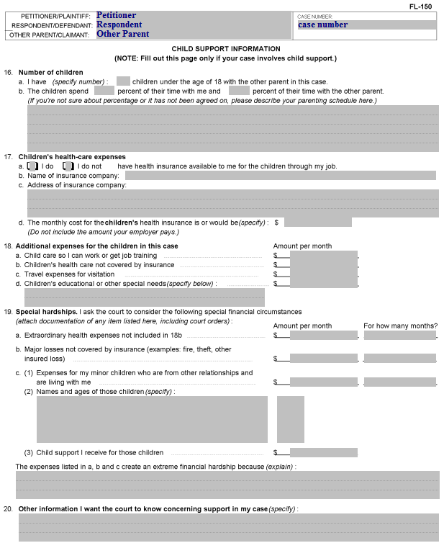
Income and Expense Declaration (page 4)
Item 16.a. Enter the number of children under the age of 18 with the other parent in the case here.
If the child is 18 but has not graduated from high school, include the child and make a note in the space provided for description.

Slide 112
Income and Expense Declaration (page 4)
Item 16.b. Enter the percentage of time the child(ren) spend with you and the percentage of time the child(ren) spend with the other parent.
If you have a weekly visitation schedule, you can determine the percentage by adding the hours of visitation and then dividing the total by 168 (there are 168 hours in a week).
For an alternate weekend schedule, you would divide the hours for the alternate weekend schedule by 336 (the number of hours in two weeks).
Note: Enter the actual current timeshare percentage if it differs from the visitation specified in a court order (e.g., if the non-custodial parent is not exercising his or her visitation rights).

Slide 113
Income and Expense Declaration (page 4)
If you are unable to determine the percentage of the timeshare between the parents, describe the current visitation schedule here.

Slide 114
Income and Expense Declaration (page 4)
Item 17.a. Check the box for whether you do or do not have health insurance available to you for the children through your job.
Item 17.b. If you checked the “I do” box, enter the name of the insurance company.
Item 17.c. Enter the address of the insurance company.
Item 17.d. Enter the cost for the children’s health insurance. Do not include the cost to cover yourself and/or your spouse. Sometimes the employer will cover the employee, but the employee will be required to pay the additional cost of insuring the employee’s children.

Slide 115
Income and Expense Declaration (page 4)
Item 18.a. Enter the amount you pay for child care so you can work or get job training OR, if you are providing proposed expenses, the amount you will be required to pay.

Slide 116
Income and Expense Declaration (page 4)
Item 18.b. Enter the amount you pay for the child(ren)’s health care costs not covered by insurance (e.g., orthodontist’s cost for braces).

Slide 117
Income and Expense Declaration (page 4)
Item 18.c. Enter your costs for travel expenses for visitation; would not include mileage for short drives, but would include expenses for long-distance visitation.
For example, if you pay for two round-trip tickets each year for your child to visit you (or the other parent), and the total cost of the tickets is $1,200, you would enter $100 here (the total divided by 12 to provide the average monthly cost).

Slide 118
Income and Expense Declaration (page 4)
Item 18. Enter the average monthly amount for the child(ren)’s educational or other special needs costs here.
This may include tuition, books, adaptive devices, etc.
Describe the expenses in the space provided. If you need additional space, attach a page labeled “Item 18.”

Slide 119
Income and Expense Declaration (page 4)
Item 19. This section is for special hardships you want the court to consider.
Item 19.a. Enter any extraordinary health expenses not included in 18.b. here.
For example, if there was a necessary emergency room visit that resulted in hospitalization of the child, you may have a bill of thousands of dollars. Enter the amount you are paying each month in the first (Amount per month) column, then enter the number of months it will take you to pay off the bill in the second (For how many months?) column.

Slide 120
Income and Expense Declaration (page 4)
Item 19. This section is for special hardships you want the court to consider.
Item 19.b. Enter the amount per month you are paying on major losses not covered by insurance, and the number of months it will take you to pay off the loss.

Slide 121
Income and Expense Declaration (page 4)
Item 19. This section is for special hardships you want the court to consider.
Item 19.c.(1) Enter the monthly amount you spend for support of biological children (not stepchildren) who are living with you, and the number of months they will be living with you (if it is a permanent living situation, you can enter “ongoing” in the second column.

Slide 122
Income and Expense Declaration (page 4)
Item 19. This section is for special hardships you want the court to consider.
Item 19.c.(2) Enter the names and ages of the child(ren) here.

Slide 123
Income and Expense Declaration (page 4)
Item 19. This section is for special hardships you want the court to consider.
Item 19.c.(3) If you receive child support for the child(ren), enter the amount you receive here.

Slide 124
Income and Expense Declaration (page 4)
Describe why the expenses in this section create a financial hardship for you here.

Slide 125
Income and Expense Declaration (page 4)
Item 20. Enter any other information you think the judge should know about your child support here.

Slide 126
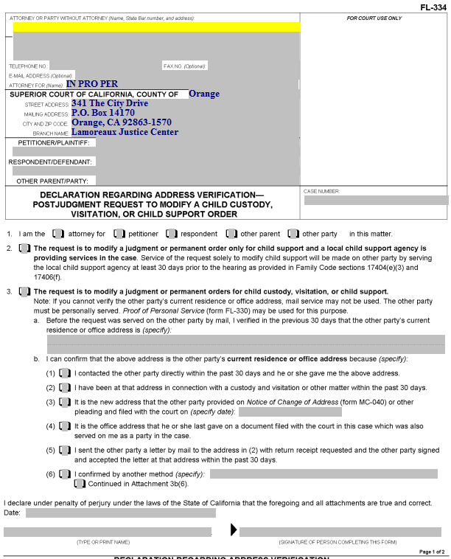
Declaration Regarding Address Verification
This form is required if you are having the other party served by mail after a judgment has been entered. It shows the court you know the address of the other person whom you will have served by mail.

Slide 127
Declaration Regarding Address Verification
Enter your information here.

Slide 128
Declaration Regarding Address Verification
Enter the Petitioner, Respondent and Other Parent (if on the original document) here.

Slide 129
Declaration Regarding Address Verification
Enter the Court case number here.

Slide 130
Declaration Regarding Address Verification
Item 1. Check the box that represents who you are in the case.

Slide 131
Declaration Regarding Address Verification
Item 2. Check this box if your Request for Order is regarding child support only and Child Support Services (County of Orange) is involved in your case.

Slide 132
Declaration Regarding Address Verification
Item 3. Check this box if you don’t check box 2.

Slide 133
Declaration Regarding Address Verification
Item 3.a. Enter the address of the other party who is being served by mail here.

Slide 134
Declaration Regarding Address Verification
Item 3.b. Check one of these boxes to indicate how you know the address is correct. If you check (6), in the space provided, describe how you know the address. If you need more space, attach a page labeled “Attachment 3b(6).”

Slide 135
Declaration Regarding Address Verification
Enter the date, print your name, and provide your signature here.

Slide 136
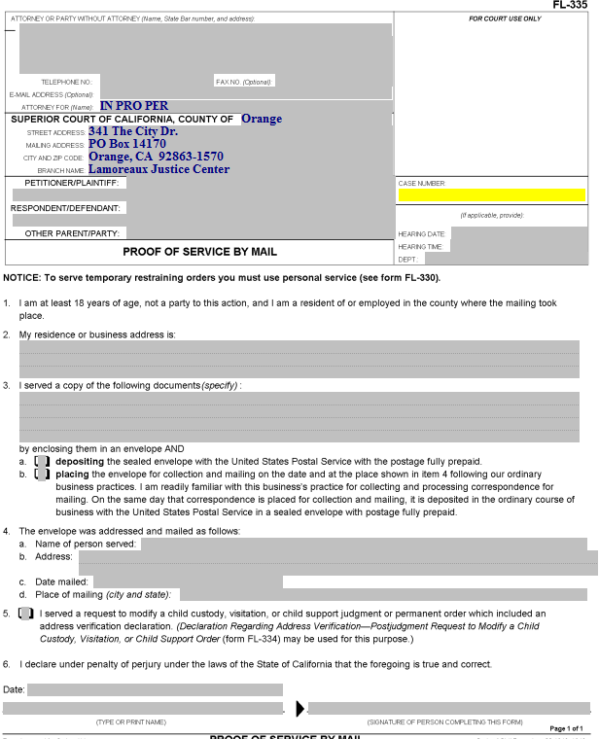
Proof of Service by Mail
Someone over the age of 18 who is not a party to the case needs to perform your actual service (i.e., placing a copy of the documents you filed into a Post Office mail box) for you. California law does not permit you to do your own service.
That person will complete this form, which you must then have filed with the court.

Slide 137
Proof of Service by Mail
Enter your information, the party names and the case number.

Slide 138
Proof of Service by Mail
Enter the date, time and courtroom (Dept.) for the hearing here.

Slide 139
Proof of Service by Mail
Item 2. The person who mails the documents for you (the “server”) will enter their address here.

Slide 140
Proof of Service by Mail
Item 3. Enter the name(s) of the actual document(s) served here (e.g., Request for Order and Supporting Declaration, Income and Expense Declaration, blank responsive pleadings).

Slide 141
Proof of Service by Mail
Item 3.a and b. The server will check one of these two boxes, depending on how the documents are mailed.

Slide 142
Proof of Service by Mail
Item 4.a. Enter the name of the person to whom the documents were mailed here.

Slide 143
Proof of Service by Mail
Item 4.b. Enter the address that the documents were mailed to here.

Slide 144
Proof of Service by Mail
Item 4.c. Your server enters the date on which the documents were mailed here.

Slide 145
Proof of Service by Mail
Item 4.d. Your server enters the city and state where the documents were mailed here.

Slide 146
Proof of Service by Mail
Item 5. This box is checked if a Declaration Regarding Address Verification was completed and filed. A copy of that Declaration should be attached to the Proof of Service.

Slide 147
Proof of Service by Mail
The server enters the mailing date, prints their name, and signs the proof of service here.
The completed Proof of Service must then be filed with the Court.

Slide 148
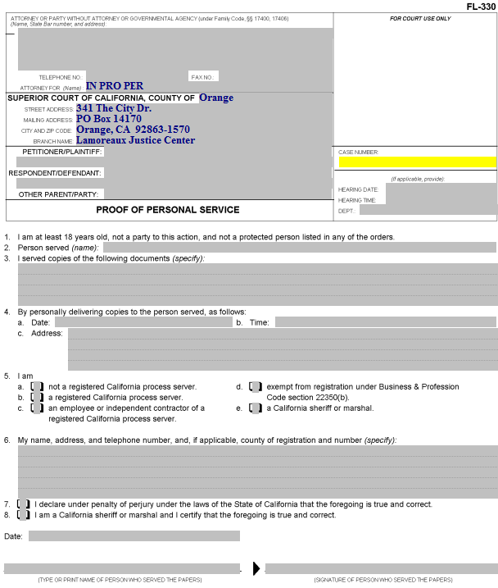
Proof of Personal Service
Someone over the age of 18 who is not a party to the case needs to do your actual service for you. California law does not permit you to do your own service.

Slide 149
Proof of Personal Service
Enter your information, the party names and the case number.

Slide 150
Proof of Personal Service
Enter the date, time and place of the hearing here.

Slide 151
Proof of Personal Service
Item 2. The server enters the name of the person served here.

Slide 152
Proof of Personal Service
Item 3. Enter the name of the documents being served (e.g., Request for Order, Income and Expense Declaration, blank responsive pleadings).

Slide 153
Proof of Personal Service
Item 4. The server enters the date, time, and address where the other party was served here.

Slide 154
Proof of Personal Service
Item 5. The category of the person performing the service is indicated by checking the appropriate box (usually “a”).

Slide 155
Proof of Personal Service
Item 6. The server enters his or her name, address and telephone number here.

Slide 156
Proof of Personal Service
Item 7. If the server is not a California sheriff or marshal, this box needs to be checked.

Slide 157
Proof of Personal Service
The server enters the date, his/her name and his/her signature here.

Slide 158
Next Steps
After you have completed all of your documents, you will need to make copies, as follows:
The original is filed with the court.
One copy is for your records.
Another copy is for the other party in the case.
If Child Support Services is involved, you will need an additional copy to be served on this agency.
If the other party has an attorney of record, you will need an additional copy to be served on the attorney.
If you would like your documents reviewed prior to filing, you can bring them to the Self-Help Center at Lamoreaux Justice Center.
You will file your documents in the Clerk’s Office at the Lamoreaux Justice Center (7th Floor, Room 706).

