Slide 1

How to Prepare a Request for Hearing Regarding Earnings Assignment/Income Withholding Order for Support
SUPERIOR COURT OF CALIFORNIA
COUNTY OF ORANGE
SELF-HELP CENTER/
FAMILY LAW FACILITATOR OFFICE

Slide 2
This document can assist you in completing the necessary paperwork for filing a Request for Hearing Regarding Earnings Assignment/Income Withholding Order for Support.
If you have received a copy of a document notifying you that an Earnings Assignment or Income Withholding Order is being imposed on you, you have 10 days from the date of receipt of the document to file a Request for Hearing Regarding Earnings Assignment/Income Withholding Order for Support.
It is recommended that you print a copy of this document first, then use the step-by-step instructions to complete the necessary forms.
You can then use the following links to go directly to the online version of the form, where you can type in the required information and then print the completed forms:
  Request for Hearing Regarding Earnings Assignment: http://www.courts.ca.gov/documents/fl450.pdf
  Declaration Regarding Address Verification: http://www.courts.ca.gov/documents/fl334.pdf
  Proof of Service by Mail: http://www.courts.ca.gov/documents/fl335.pdf
  Proof of Personal Service: http://www.courts.ca.gov/documents/fl330.pdf
Once you have completed and signed the appropriate forms, you can file them at the Lamoreaux Justice Center, Room 706 (on the 7th floor). You will need to bring the appropriate number of stamped, addressed envelopes and the appropriate number of copies for filing.
If you would like someone to review your finished documents before filing them, you can bring them to the Self-Help Center at the Lamoreaux Justice Center.

Slide 3
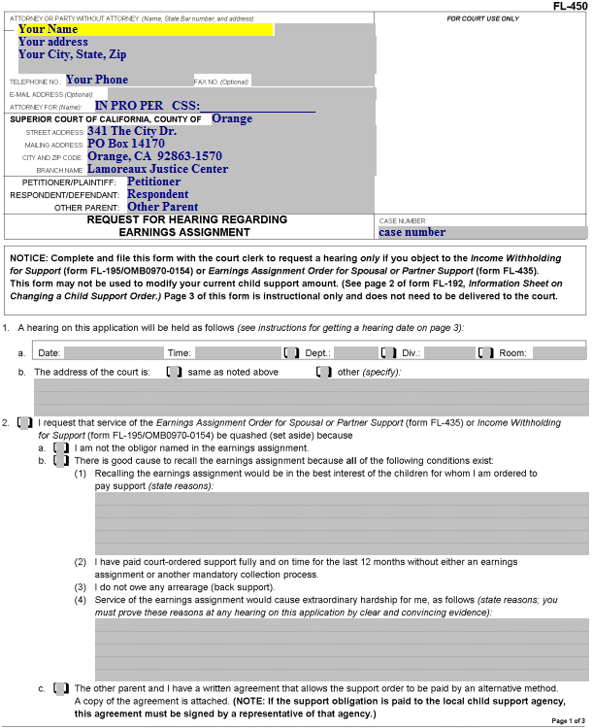
Request for Hearing Regarding Earnings Assignment
Enter your information (name, address, phone number) here.

Slide 4
Request for Hearing Regarding Earnings Assignment
Enter “IN PRO PER” here (this means that you do not have an attorney and are representing yourself).

Slide 5
Request for Hearing Regarding Earnings Assignment
If the Department of Child Support Services (DCSS) is involved in your case, enter your CSS case number here.

Slide 6
Request for Hearing Regarding Earnings Assignment
Enter this information (the Court’s name and address) here. Copy the information shown.

Slide 7
Request for Hearing Regarding Earnings Assignment
Enter the Petitioner’s name, the Respondent’s name, and, if applicable, the Other Parent’s name here.
This should be the same as on the original filing document. If you were the Respondent in that document, you will be the Respondent here.

Slide 8
Request for Hearing Regarding Earnings Assignment
Enter the Court case number here.

Slide 9
Request for Hearing Regarding Earnings Assignment
After filing, the date, time and location of the hearing will be shown here.

Slide 10
Request for Hearing Regarding Earnings Assignment
Check this box.

Slide 11
Request for Hearing Regarding Earnings Assignment
Item 2. Check this box if you are requesting that the earnings assignment order or income withholding order be quashed (set aside).

Slide 12
Request for Hearing Regarding Earnings Assignment
Item 2.a. Check this box if you are not the obligor (person required to pay) named in the earnings assignment/income withholding order.

Slide 13
Request for Hearing Regarding Earnings Assignment
Item 2.b. Check this box if ALL of the following apply (if not all conditions are present, you cannot use 2.b.
It would be in the best interest of the children involved (provide your reasons in the space provided.
You have paid your support on time for the last 12 months without a mandatory collection process.
You do not owe any back support.
There are extraordinary hardships (Provide the reasons and be prepared to provide proof at the hearing).

Slide 14
Request for Hearing Regarding Earnings Assignment
Item 2.c. Check this box if you have a written agreement allowing support to be paid by an alternative method. A signed copy of the agreement must be attached.

Slide 15
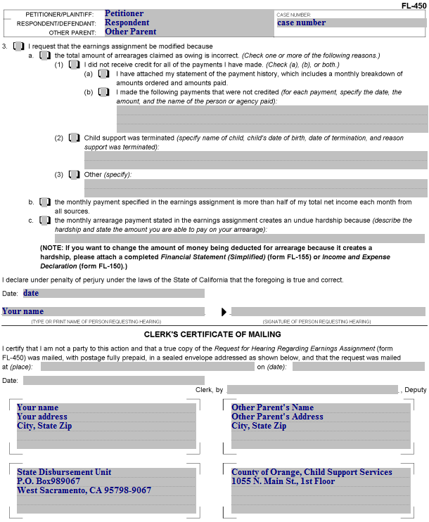
Request for Hearing Regarding Earnings Assignment (page 2)
Enter the Petitioner’s name, the Respondent’s name, and the Other Parent’s name (if applicable) and the case number here. These will be the same as on page 1.

Slide 16
Request for Hearing Regarding Earnings Assignment (page 2)
Item 3. Check this box if you are requesting that the order be modified rather than set aside.

Slide 17
Request for Hearing Regarding Earnings Assignment (page 2)
Item 3.a. Check this box if the arrearages (back support) claimed as owing is incorrect. You must also check one of the boxes ((1), (2) or (3).

Slide 18
Request for Hearing Regarding Earnings Assignment (page 2)
Item 3.a.(1) Check this box if you have not received credit for all of the payments you have made, then check (a) (b) or both.
Check this box if you are attaching a payment history, which includes a monthly breakdown of amounts ordered and amounts paid (see Payment History Attachment following this document).
Check this box to list payments that were not credited, and list each payment, the date, the amount, and the name of the person or agency paid.

Slide 19
Request for Hearing Regarding Earnings Assignment (page 2)
Item 3.a.(2) Check this box if child support was terminated and enter the child’s name, date of birth, date of termination of child support, and the reason for termination (e.g., the child is 18 and has graduated from high school, or the child is now living with you full time). Provide supporting documentation for your reason(s).

Slide 20
Request for Hearing Regarding Earnings Assignment (page 2)
Item 3.a.(3) Check this box for other reasons the order should be modified, and specify the reasons in the space provided.

Slide 21
Request for Hearing Regarding Earnings Assignment (page 2)
Item 3.b. Check this box if the monthly payment specified in the earnings assignment is more than 50% of your total net income each month from all sources.
Net income means gross income minus any required deductions (e.g., Federal Income Tax, CA Income Tax, social security (FICA), CA State Disability Insurance (CASDI))

Slide 22
Request for Hearing Regarding Earnings Assignment (page 2)
Item 3.c. Check this box if the monthly payment specified for arrearages (back support) in the earnings assignment creates a hardship for you.
Describe the hardship and state the amount you are able to pay on your arrearage in the space provided. Attach a page labeled “3.c” if you need additional space.

Slide 23
Request for Hearing Regarding Earnings Assignment (page 2)
Enter the date, your name and signature here.

Slide 24
Request for Hearing Regarding Earnings Assignment (page 2)
You will need to enter the addresses for the clerk to mail the documents to, and you will also need addressed and stamped envelopes.
Most cases will include the State Disbursement Unit – use the address shown.
If DCSS is involved, use the address shown for “County of Orange, Child Support Services

Slide 25
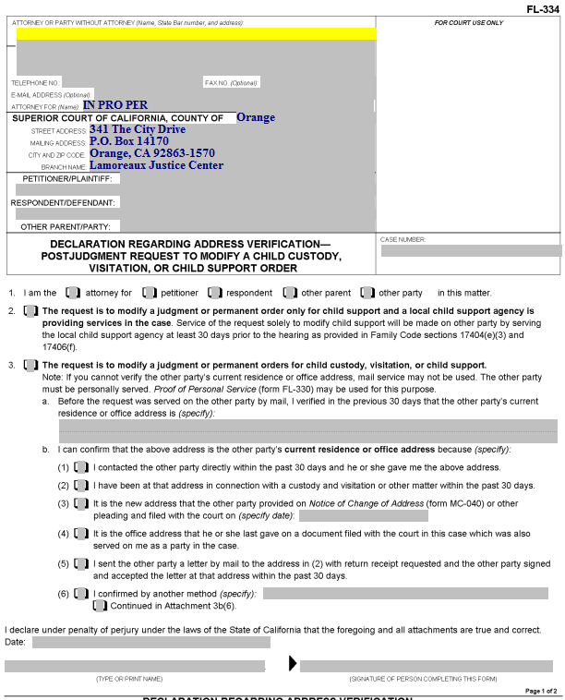
Declaration Regarding Address Verification
This form is required if you are having the other party served by mail after a Judgment has been entered. It shows the court you know the address of the other person to be served by mail.

Slide 26
Declaration Regarding Address Verification
Enter your information here.

Slide 27
Declaration Regarding Address Verification
Enter the Petitioner, Respondent and Other Parent (if on the original document) here.

Slide 28
Declaration Regarding Address Verification
Enter the Court case number here.

Slide 29
Declaration Regarding Address Verification
Item 1. Check the box that represents who you are in the case.

Slide 30
Declaration Regarding Address Verification
Item 2. Check this box if your Request for Order is regarding child support only and Child Support Services (County of Orange) is involved in your case.

Slide 31
Declaration Regarding Address Verification
Item 3. Check this box if you don’t check box 2.

Slide 32
Declaration Regarding Address Verification
Item 3.a. Enter the address of the party who is being served by mail here.

Slide 33
Declaration Regarding Address Verification
Item 3.b. Check one of these boxes to indicate how you know the address is correct. If you check (6), describe how you know the address in the space provided. If you need more space, attach a page labeled “Attachment 3b(6).”

Slide 34
Declaration Regarding Address Verification
You will enter the date, print your name, and provide your signature here.

Slide 35
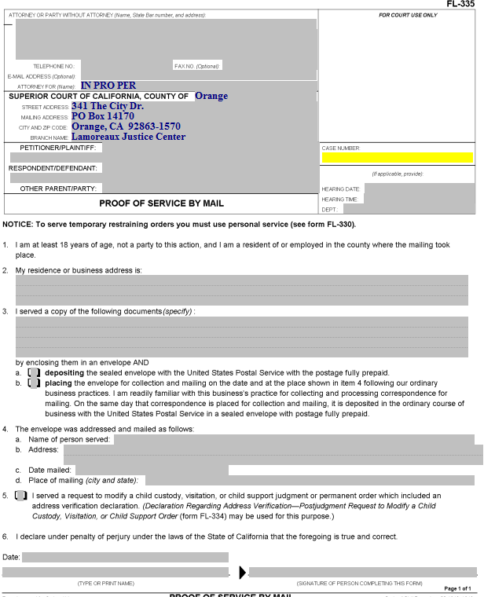
Proof of Service by Mail
Someone over the age of 18 who is not a party to the case needs to perform your actual service (i.e., placing a copy of the documents you filed into a Post Office mail box) for you. California law does not permit you to do your own service.
That person will complete the form, which you must then file with the court.

Slide 36
Proof of Service by Mail
Enter your information, the party names and the case number.

Slide 37
Proof of Service by Mail
Enter the date, time and courtroom (Dept.) for the hearing here.

Slide 38
Proof of Service by Mail
Item 2. The address of the person who does your service for you (the server) is entered here (by the server).

Slide 39
Proof of Service by Mail
Item 3. Enter the name(s) of the actual document(s) served here (e.g., Request for Order and Supporting Declaration, Income and Expense Declaration, blank responsive pleadings).

Slide 40
Proof of Service by Mail
Item 3.a and b. The server will check one of these two boxes, depending on how the documents are mailed.

Slide 41
Proof of Service by Mail
Item 4.a. Enter the name of the person to whom the documents were mailed here.

Slide 42
Proof of Service by Mail
Item 4.b. Enter the address that the documents were mailed to here.

Slide 43
Proof of Service by Mail
Item 4.c. Your server enters the city and state where the documents were mailed here.

Slide 44
Proof of Service by Mail
Item 4.d. Your server enters the city and state where the documents were mailed here.

Slide 45
Proof of Service by Mail
Item 5. This box is checked if a Declaration Regarding Address Verification was completed and filed. A copy of that Declaration should be attached to the Proof of Service.

Slide 46
Proof of Service by Mail
The person who does the mailing dates, prints their name, and signs the proof of service here.
The Proof of Service must then be filed with the Court.

Slide 47
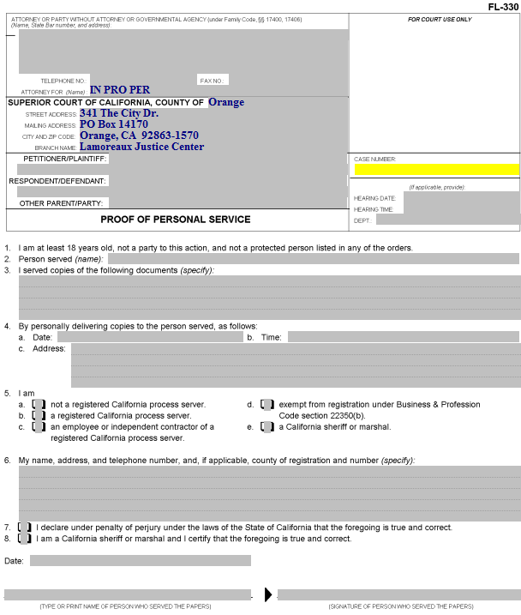
Proof of Personal Service
Someone over the age of 18 who is not a party to the case needs to do your actual service for you.
That person will complete this form, which you must then file with the court.

Slide 48
Proof of Personal Service
Enter your information, the party names and the case number.

Slide 49
Proof of Personal Service
Enter the date, time and place of the hearing here.

Slide 50
Proof of Personal Service
Item 2. The person doing the service enters the name of the person served here.

Slide 51
Proof of Personal Service
Item 3. Enter the name of the documents being served (e.g., Request for Order, Income and Expense Declaration, blank responsive pleadings).

Slide 52
Proof of Personal Service
Item 4. The person doing the service enters the date, time, and address where the other party was served here.

Slide 53
Proof of Personal Service
Item 5. The category of the person performing the service is indicated by checking the appropriate box (usually “a”).

Slide 54
Proof of Personal Service
Item 6. The person doing the service enters his or her name, address and telephone number here.

Slide 55
Proof of Personal Service
Item 7. If the server is not a California sheriff or marshal, this box needs to be checked.

Slide 56
Proof of Personal Service
The date, name of the person performing the service and his/her signature goes here.

Slide 57
Next Steps
After you have completed all of your documents, you will need to make copies, as follows:
The original is filed with the court.
Up to four copies, along with stamped, addressed envelopes, need to be made as follows:
  One copy for yourself, with one stamped envelope addressed to yourself.
  One copy for the other parent, with one stamped envelope addressed to her/him. If you do not know the address of the other parent, and Child Support Services is involved in the case, you can address the envelope to “(Other Parent Name), c/o Child Support Services” and use the address for Child Support services, below.
  One copy for the State Disbursement Unit, with one stamped envelope addressed as follows:
    State Disbursement Unit
    P.O. Box 98067
    West Sacramento CA 95798-906
  (If applicable) One copy for Child Support Services, addressed as follows:
    County of Orange; Child Support Services
    1055 N. Main St., 1st Floor
    Santa Ana CA 92701
If you would like your documents reviewed prior to filing, you can bring them to the Self-Help Center at Lamoreaux Justice Center.
You will file your documents in the Clerk’s Office at the Lamoreaux Justice Center (7th Floor, Room 706).

