Slide 1

How to Prepare Court Forms to Request a Judicial Determination of Support Arrearages
SUPERIOR COURT OF CALIFORNIA
COUNTY OF ORANGE
SELF-HELP CENTER/
FAMILY LAW FACILITATOR OFFICE

Slide 2
This document can assist you in completing the necessary paperwork for filing a Request for Judicial Determination of Support Arrearages
It is recommended that you print a copy of this document first, then use the step-by-step instructions to complete the necessary forms.
You can then use the following links to go directly to the online version of the form, where you can type in the required information and then print the completed forms:
  Request for Judicial Determination of Support Arrearages : http://www.courts.ca.gov/documents/fl676.pdf
  Declaration of Payment History: http://www.courts.ca.gov/documents/fl420.pdf
  Payment History Attachment: http://www.courts.ca.gov/documents/fl421.pdf
  Declaration Regarding Address Verification: http://www.courts.ca.gov/documents/fl334.pdf
  Proof of Service by Mail: http://www.courts.ca.gov/documents/fl335.pdf
  Proof of Personal Service: http://www.courts.ca.gov/documents/fl330.pdf
Once you have completed and signed the appropriate forms, you can file them at the Lamoreaux Justice Center, Room 706 (on the 7th floor).
If you would like someone to review your finished documents before filing them, you can bring them to the Self-Help Center at the Lamoreaux Justice Center.

Slide 3
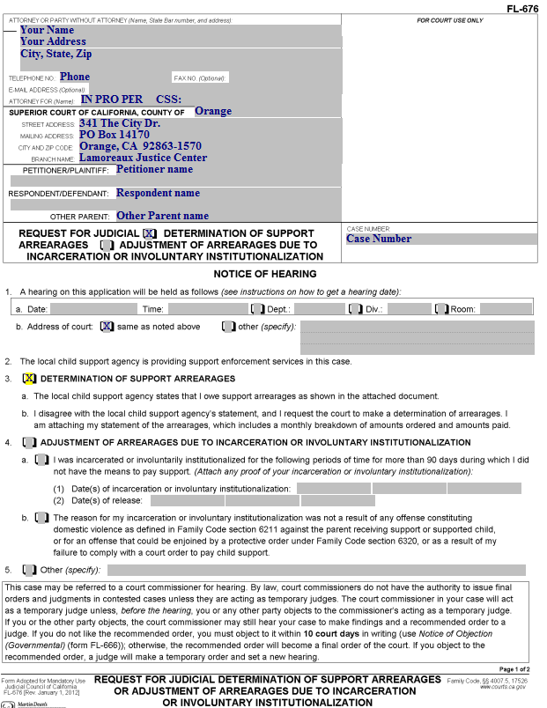
Request for Judicial Determination of Support Arrearages
(page 1)
Enter your address and phone number here.

Slide 4
Request for Judicial Determination of Support Arrearages
(page 1)
“IN PRO PER” means you do not have an attorney, but are representing yourself. Enter this on this line.
If Child Support Services is involved, you will have a CSS case number, which should be entered here.

Slide 5
Request for Judicial Determination of Support Arrearages
(page 1)
Enter this information on the form.

Slide 6
Request for Judicial Determination of Support Arrearages
(page 1)
Enter the Petitioner’s Name, Respondent’s name, and (if appropriate) the Other Parent’s name here.
Note: Use another filed document for this. The case caption does not change. If you are the Respondent named in the original filing document in the case, you will always be the Respondent, even if you are the one filing the Request.

Slide 7
Request for Judicial Determination of Support Arrearages
(page 1)
Enter your court case number here.

Slide 8
Request for Judicial Determination of Support Arrearages
(page 1)
Check this box.

Slide 9
Request for Judicial Determination of Support Arrearages
(page 1)
Check this box.

Slide 10
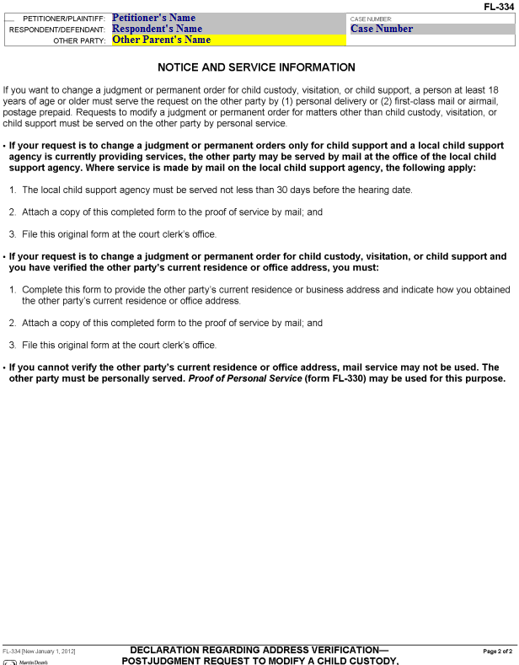
Request for Judicial Determination of Support Arrearages
(page 2)
Enter the Petitioner’s name, the Respondent’s name, the Other Parent’s name (if applicable) and the Case number here.

Slide 11
Preparing your supporting documents
You will need to provide evidence of all payments you have made for your support payments.
After you have gathered your documents, arrange them in chronological order, and make one copy on 8.5” x 11” paper. This will become your original for filing purposes.

Slide 12
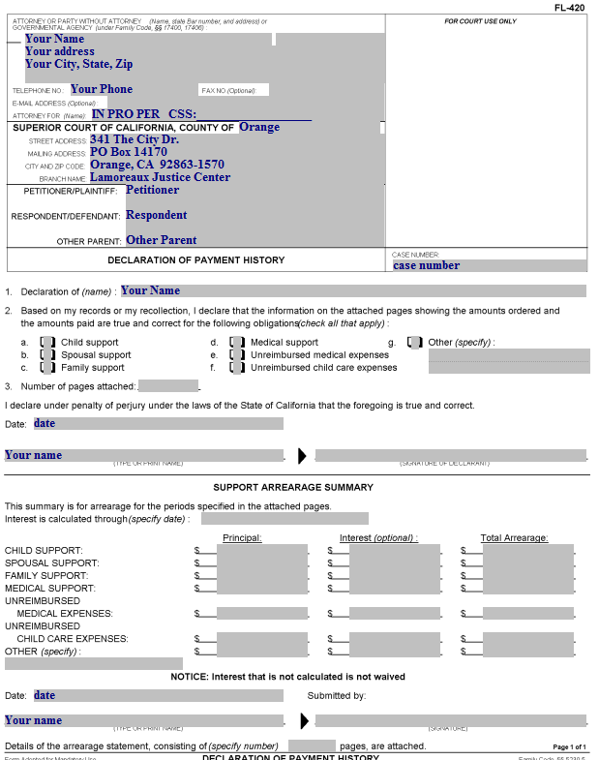
Declaration of Payment History
This is where the information from the Payment History Attachment(s) will be added.
The information in these areas should be the same as on the Request for Judicial Determination of Support Arrearages.

Slide 13
Declaration of Payment History
This is where the information from the Payment History Attachment(s) will be added.
Enter your name here.

Slide 14
Declaration of Payment History
This is where the information from the Payment History Attachment(s) will be added.
Check the box for each type of payment you are seeking (remember, you need to do a separate Payment History Attachment for each type).

Slide 15
Declaration of Payment History
This is where the information from the Payment History Attachment(s) will be added.
Enter the number of attached pages here (this document is page 1, the Payment History Attachment(s) starts at page 2, followed by your supporting documents).

Slide 16
Declaration of Payment History
This is where the information from the Payment History Attachment(s) will be added.
Enter the date, your name and sign here.

Slide 17
Declaration of Payment History
This is where the information from the Payment History Attachment(s) will be added.
This section will be completed after you complete your Payment History Attachment(s).

Slide 18
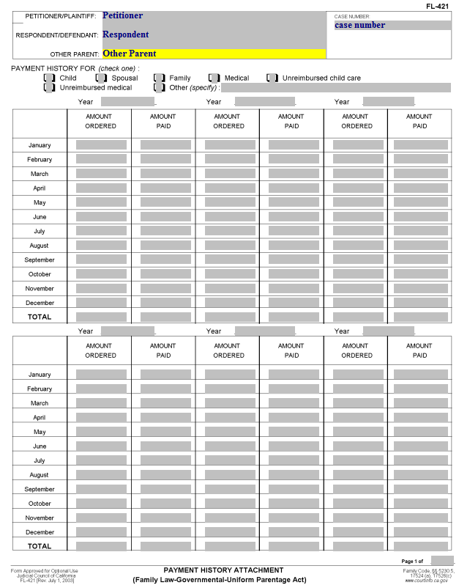
Payment History Attachment
This form is used to calculate the amount that will be the subject of the Request for Judicial Determination of Support Arrearages.
Enter the Petitioner’s name, the Respondent’s name, the Other Parent’s name (if applicable) and the Case Number.

Slide 19
Payment History Attachment
Check the box for the type of payment history you are entering.
You must use a different Payment History Attachment for each type of support/expense (you may not combine them on one form).

Slide 20
Payment History Attachment
For each year, enter the year (e.g., 2012) here. You can show information for up to 6 years on a single page.

Slide 21
Payment History Attachment
This column is for the “Amount Ordered.”
For Direct Expenses (e.g., child or spousal support), enter the amount ordered for each month).

Slide 22
Payment History Attachment
This column is for the “Amount Paid” by you in that month.

Slide 23
Payment History Attachment
For each year, you need to total the “Amount Ordered” and “Amount Paid” columns.
Using a scratch piece of paper, total all of the “Amount Ordered” yearly totals.
Total all of the “Amount Paid” yearly totals.
Subtract the total of the amount paid from the total of the amount ordered. This is the amount that will be entered on the Declaration of Payment History.

Slide 24
Declaration of Payment History
This is where the information from the Payment History Attachment(s) will be added.
For each category for which you prepared a Payment History Attachment, enter the total unpaid amount (Total of Amount Ordered minus Total of Amount Paid) here.

Slide 25
Declaration of Payment History
This is where the information from the Payment History Attachment(s) will be added.
Enter the amount for the “Principal” column here.

Slide 26
Declaration of Payment History
This is where the information from the Payment History Attachment(s) will be added.
Enter the date, your name, and signature here.

Slide 27
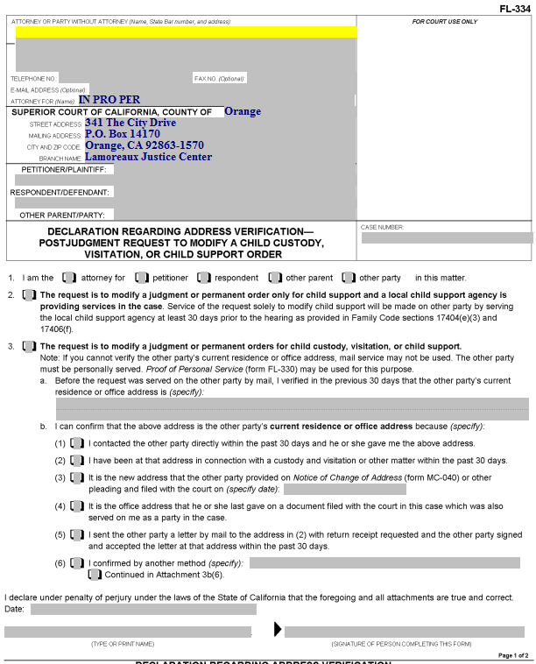
Declaration Regarding Address Verification
This form shows the court you know the address of the person to whom you will be mailing a copy of the Service Documents.
It is required for all Proofs of Service by Mail for documents served after Judgment is entered in a case.

Slide 28
Declaration Regarding Address Verification
Enter your information here.

Slide 29
Declaration Regarding Address Verification
Enter the Petitioner, Respondent and Other Parent (if on the original document) here.

Slide 30
Declaration Regarding Address Verification
Enter the Court case number here.

Slide 31
Declaration Regarding Address Verification
Item 1. Check the box that represents who you are in the case.

Slide 32
Declaration Regarding Address Verification
Item 2. Check this box if your Request for Order is regarding child support only and Child Support Services (County of Orange) is involved in your case.

Slide 33
Declaration Regarding Address Verification
Item 3. Check this box if you don’t check box 2.

Slide 34
Declaration Regarding Address Verification
Item 3.a. Enter the address of the party who is being served by mail here.

Slide 35
Declaration Regarding Address Verification
Item 3.b. Check one of these boxes to indicate how you know the address is correct. If you check (6), in the space provided, describe how you know the address. If you need more space, attach a page labeled “Attachment 3b(6).”

Slide 36
Declaration Regarding Address Verification
Enter the date, print your name, and provide your signature here.

Slide 37
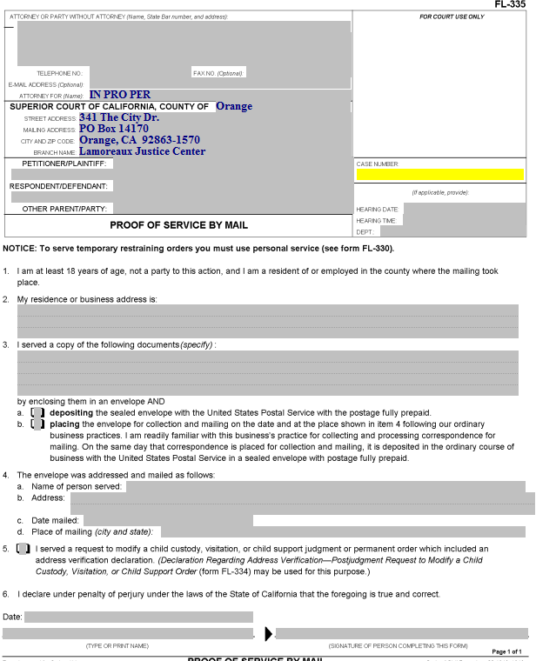
Proof of Service by Mail
Someone over the age of 18 who is not a party to the case needs to perform your actual service (i.e., placing a copy of the documents you filed into a Post Office mail box) for you. California law does not permit you to do your own service.
That person (the “server”) will complete this form, which you must then have filed with the court.

Slide 38
Proof of Service by Mail
Enter your information, the party names and the case number.

Slide 39
Proof of Service by Mail
Enter the date, time and courtroom (Dept.) for the hearing here.

Slide 40
Proof of Service by Mail
Item 2. The person who mails the documents for you (the “server”) will enter their address here.

Slide 41
Proof of Service by Mail
The address of the person who does your service for you (the server) is entered here (by the server)

Slide 42
Proof of Service by Mail
Item 3. Enter the name(s) of the actual document(s) served here (e.g., Request for Order and Supporting Declaration, Income and Expense Declaration, blank responsive pleadings).

Slide 43
Proof of Service by Mail
Item 3.a and b. The server will check one of these two boxes, depending on how the documents are mailed.

Slide 44
Proof of Service by Mail
Item 4.a. Enter the name of the person to whom the documents were mailed here.

Slide 45
Proof of Service by Mail
Item 4.b. Enter the address that the documents were mailed to here.

Slide 46
Proof of Service by Mail
Item 4.c. Your server enters the date on which the documents were mailed here.

Slide 47
Proof of Service by Mail
Item 4.d. Your server enters the city and state where the documents were mailed here.

Slide 48
Proof of Service by Mail
Item 5. This box is checked if a Declaration Regarding Address Verification was completed and filed. A copy of that Declaration should be attached to the Proof of Service.

Slide 49
Proof of Service by Mail
The server dates, prints their name, and signs the proof of service here.
The Proof of Service must then be filed with the Court.

Slide 50
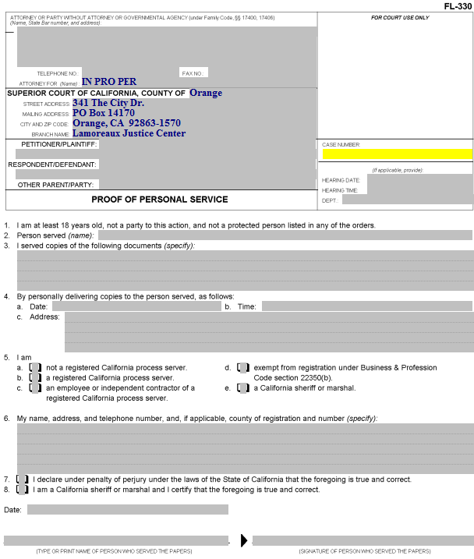
Proof of Personal Service
Someone over the age of 18 who is not a party to the case needs to do your actual service for you. California law does not permit you to do your own service.

Slide 51
Proof of Personal Service
Enter your information, the party names and the case number.

Slide 52
Proof of Personal Service
Enter the date, time and place of the hearing here.

Slide 53
Proof of Personal Service
Item 2. The server enters the name of the person served here.

Slide 54
Proof of Personal Service
Item 3. Enter the name of the documents being served (e.g., Request for Order, Income and Expense Declaration, blank responsive pleadings).

Slide 55
Proof of Personal Service
Item 4. The server enters the date, time, and address where the other party was served here.

Slide 56
Proof of Personal Service
Item 5. The category of the person performing the service is indicated by checking the appropriate box (usually “a”).

Slide 57
Proof of Personal Service
Item 6. The server enters her/his name, address and telephone number here.

Slide 58
Proof of Personal Service
Item 7. If the server is not a California sheriff or marshal, this box needs to be checked.

Slide 59
Proof of Personal Service
The server dates, prints his/her name, and provides a signature here.

Slide 60
Next Steps
After you have completed all of your documents, you will need to make copies, as follows:
The original is filed with the court.
One copy is for your records.
Another copy is for the other party in the case.
If Child Support Services is involved, you will need an additional copy to be served on this agency.
If the other party has an attorney of record, you will need an additional copy to be served on the attorney.
If you would like your documents reviewed prior to filing, you can bring them to the Self-Help Center at Lamoreaux Justice Center.
You will file your documents in the Clerk’s Office at the Lamoreaux Justice Center (7th Floor, Room 706).

