Slide 1

How to Prepare an Income Withholding Order
SUPERIOR COURT OF CALIFORNIA
COUNTY OF ORANGE
SELF-HELP CENTER/
FAMILY LAW FACILITATOR OFFICE

Slide 2
This document can assist you in preparing an Income Withholding Order. This document is used when there is a court order for an earnings assignment or withholding order, to garnish the wages of the person required to pay support.
It is recommended that you print a copy of this document first, then use the step-by-step instructions to complete the necessary forms.
You can then use the following links to go directly to the online version of the form, where you can type in the required information and then print the completed form:
  Income Withholding Order: http://www.courts.ca.gov/documents/fl195.pdf
Once you have completed and signed the form, you can file it together with the appropriate Request (e.g. Ex-Parte Request for Earnings Assignment Order) at the Lamoreaux Justice Center, Room 706 (on the 7th floor). You will need to bring the appropriate number of stamped, addressed envelopes and the appropriate number of copies for filing.
If you would like someone to review your finished documents before filing them, you can bring them to the Self-Help Center at the Lamoreaux Justice Center.

Slide 3
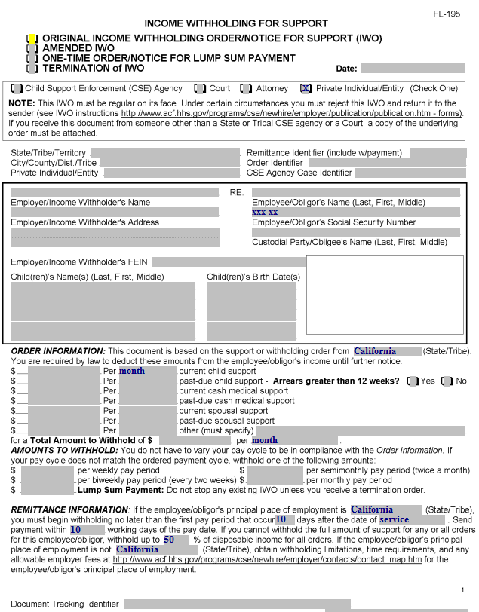
Income Withholding Order
(page 1)
Check this box if this is the first Income Withholding Order for the case.

Slide 4
Income Withholding Order
(page 1)
Check this box if this is an amended Income Withholding Order for the case.

Slide 5
Income Withholding Order
(page 1)
Check this box if this is a One Time Order of a Notice for a Lump Sum Payment.

Slide 6
Income Withholding Order
(page 1)
Check this box if this is a Termination of an Income Withholding Order.

Slide 7
Income Withholding Order
(page 1)
Check this box to indicate you are a private individual/entity using the form.

Slide 8
Income Withholding Order
(page 1)
Enter your name here.

Slide 9
Income Withholding Order
(page 1)
Enter your Court case number here.

Slide 10
Income Withholding Order
(page 1)
Enter the short case title for your case (Petitioner’s last name v. Respondent’s last name here.

Slide 11
Income Withholding Order
(page 1)
If Child Support Services (CSS or DCSS) is involved in your case, enter the CSS case number here.

Slide 12
Income Withholding Order
(page 1)
Enter the employer or income withholder’s name here.

Slide 13
Income Withholding Order
(page 1)
Enter the employer or income withholder’s address here.

Slide 14
Income Withholding Order
(page 1)
Enter the last name, first name and middle name (in that order) of the person whose wages will be affected by the order (Employee/Obligor) here.

Slide 15
Income Withholding Order
(page 1)
If this document will be filed with the court, leave this blank (the Court does not permit the filing of documents with social security numbers on them).

Slide 16
Income Withholding Order
(page 1)
Enter the last name, first name, and middle name (in that order) of the person who will receive the wages withheld (Custodial Party/Obligee) here.

Slide 17
Income Withholding Order
(page 1)
If you know the Employer/Income Withholder’s FEIN number, enter it here.

Slide 18
Income Withholding Order
(page 1)
Enter the last, first and middle name (in that order) of each child involved and their date of birth here.

Slide 19
Income Withholding Order
(page 1)
Enter the state where the most recent support or withholding order was made here (California in most cases).

Slide 20
Income Withholding Order
(page 1)
Enter the monthly amount of the current child support order here.

Slide 21
Income Withholding Order
(page 1)
Enter “month” for each line item completed here.

Slide 22
Income Withholding Order
(page 1)
Enter the monthly amount to be collected for past-due child support (arrears) here, and check the box for whether the arrears are for a period greater than 12 weeks.

Slide 23
Income Withholding Order
(page 1)
Enter the monthly amount to be collected for current cash medical support here (e.g., the monthly amount to be collected for required health insurance to be paid by the Obligor).

Slide 24
Income Withholding Order
(page 1)
Enter the monthly amount to be collected for past-due cash medical support here (e.g., the monthly amount to be collected for unreimbursed medical expenses that you have paid for where there is an order for the Obligor to pay all or a portion of such expenses).

Slide 25
Income Withholding Order
(page 1)
Enter the monthly amount to be collected for past-due cash medical support here (e.g., the monthly amount to be collected for unreimbursed medical expenses that you have paid for where there is an order for the Obligor to pay all or a portion of such expenses).

Slide 26
Income Withholding Order
(page 1)
Enter the monthly amount to be collected for current spousal support.

Slide 27
Income Withholding Order
(page 1)
Enter the monthly amount to be collected for past-due spousal support.

Slide 28
Income Withholding Order
(page 1)
Enter the monthly amount to be collected for other support, and specify what that support is in the space provided.

Slide 29
Income Withholding Order
(page 1)
Enter the total monthly amount to be collected for all above entries.

Slide 30
Income Withholding Order
(page 1)
You must complete all of the pay period options.
Multiply the total monthly amount by 12 and divide the result by 52, and enter that result here for a weekly pay period.

Slide 31
Income Withholding Order
(page 1)
Multiply the total monthly amount by 12 and divide the result by 26, and enter that result here for a biweekly pay period.

Slide 32
Income Withholding Order
(page 1)
Enter the total monthly amount here for a monthly pay period.

Slide 33
Income Withholding Order
(page 1)
If there is to be a lump sum payment withheld, enter the amount here.

Slide 34
Income Withholding Order
(page 1)
Enter the information shown here.

Slide 35
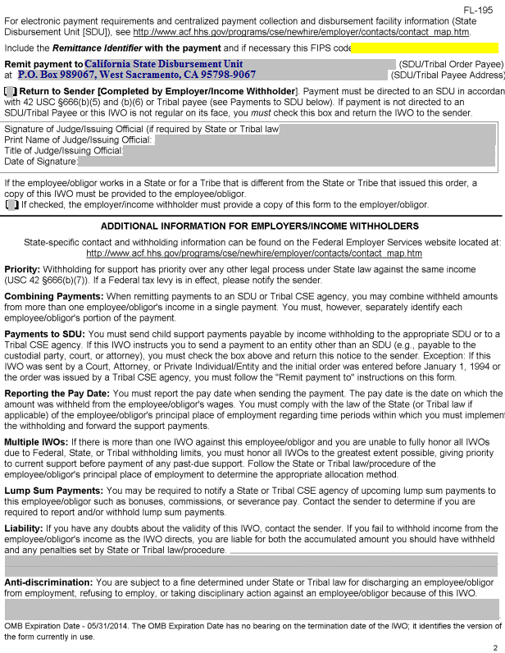
Income Withholding Order
(page 2)
In most cases, payments will go through the California State Disbursement Unit. Enter this address in this space.
If you have an order specifying a different payment method, enter the name and address of the person who will receive the withheld funds.

Slide 36
Income Withholding Order
(page 2)
Check this box if you wish to have a copy of this form provided to the Obligor (person whose wages are being withheld).

Slide 37
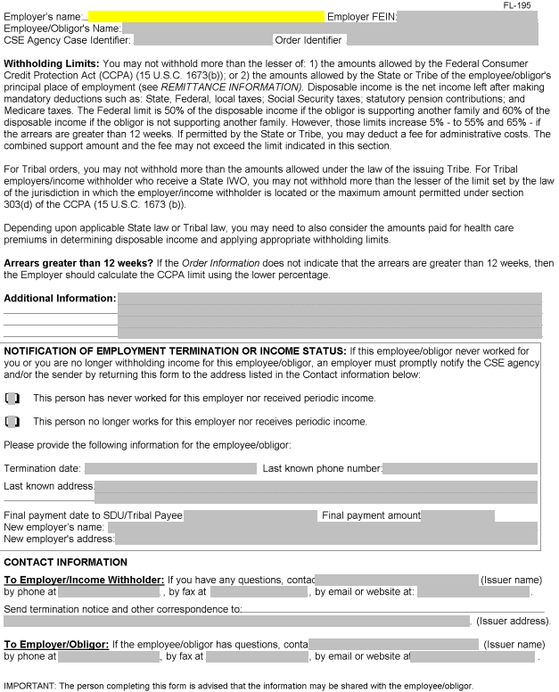
Income Withholding Order
(page 3)
Enter the employer’s name here.

Slide 38
Income Withholding Order
(page 3)
If you know the employer’s FEIN, enter it here.

Slide 39
Income Withholding Order
(page 3)
Enter the Employee/Obligor’s name here (first, middle, last).

Slide 40
Income Withholding Order
(page 3)
If Child Support Services is involved in the case, enter the CSS case number here.

Slide 41
Income Withholding Order
(page 3)
Enter the Order Identifier (short case title from page 1) here.

Slide 42
Next Steps
If you would like your documents reviewed prior to filing, you can bring them to the Self-Help Center at Lamoreaux Justice Center.
You will file your documents in the Clerk’s Office at the Lamoreaux Justice Center (7th Floor, Room 706).

