Slide 1

How to Write a Declaration for the Court
To begin this demonstration:
On the toolbar at the top of the screen, please click on “Slide Show”, and then click on “From Beginning”

Slide 2
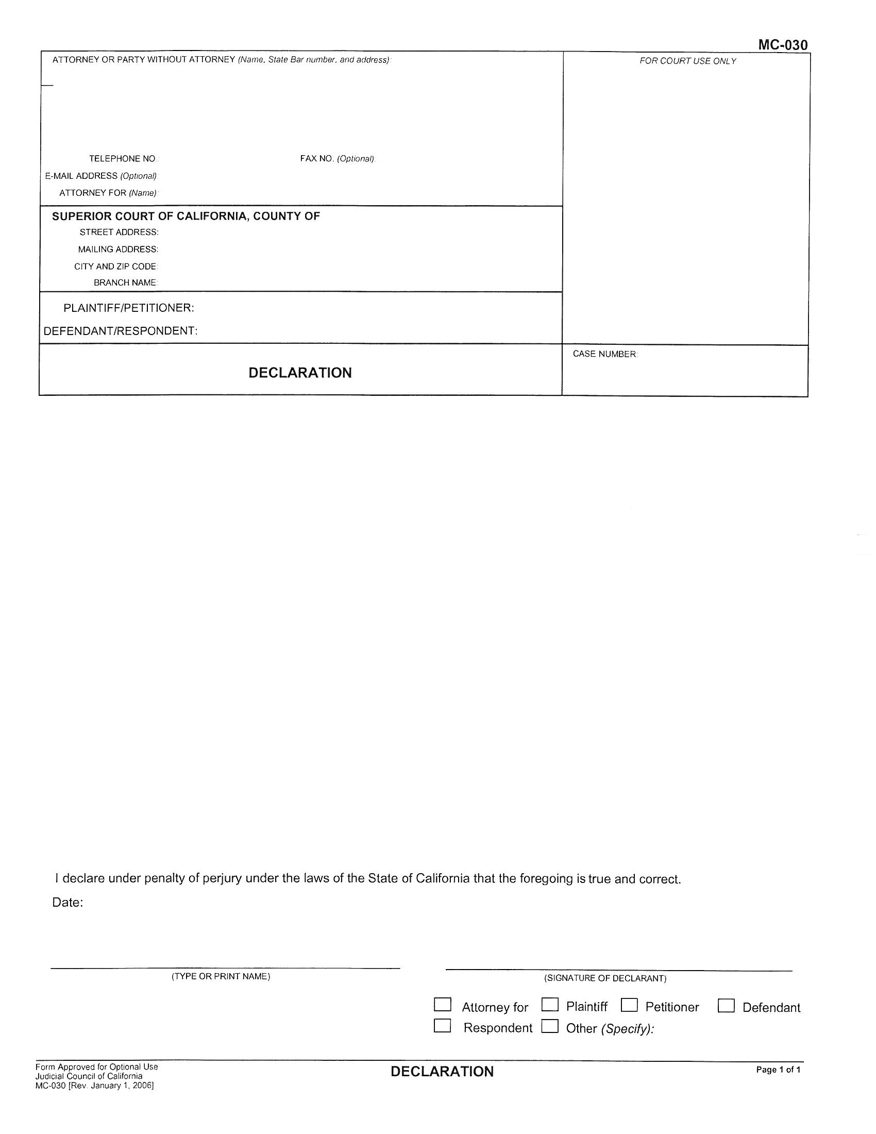

Slide 3
provide FACTS, not opinions or conclusions

Slide 5
provide FACTS, not opinions or conclusions

Slide 7
provide FACTS, not opinions or conclusions

Slide 8


Slide 11
How do you know that?

Slide 12
My spouse makes a lot of money and can afford to pay child support.

Slide 13
How do you know that?

Slide 14
My spouse works for the County.
The W-2 form that came in the mail showed wages of $65,000 last year.

Slide 15
My spouse uses drugs.

Slide 16
How do you know that?

Slide 17
On January 3, 2012, in the bathroom of our home, I saw my spouse injecting a drug; and when I asked what it was, my spouse said “It’s meth.”

Slide 18
My spouse is abusive to our children.

Slide 19
How do you know that?

Slide 20
My spouse has been abusive to me.

Slide 21
How do you know that?

Slide 22
My spouse is not a good parent to our children.

Slide 23
How do you know that?

Slide 24
outline your declaration

Slide 25
1. My ex-spouse’s apartment does not have a bedroom for the children
2. My ex-spouse has loud, all-night parties with drinking
3. My ex-spouse often travels out of town for work

Slide 26
1. My ex-spouse’s apartment does not have a bedroom for the children

Slide 27
1. My ex-spouse’s apartment does not have a bedroom for the children
(how do you know that?)

Slide 28
1. My ex-spouse’s apartment does not have a bedroom for the children
On May 2, 2012, I went to my ex-spouse’s studio apartment at 100 Leaf Street and saw that it has no bedroom for the children. My ex-spouse told me that they sleep on the couch in the living room.

Slide 29
2. My ex-spouse has loud, all-night parties with drinking
(how do you know that?)

Slide 30
3. My ex-spouse often travels out of town for work
(how do you know that?)

Slide 31
short and to the point

Slide 32
personal knowledge

Slide 33
On January 4, 2012, I saw …

Slide 34
On January 4, 2012, my spouse said to me …

Slide 35
but not:
On January 4, 2012, my neighbor Jane Smith said …

Slide 36
arrange a series of events in order, starting with the most recent

Slide 37
for a responsive declaration, answer each point in order

Slide 38
proofread

Slide 39
fillable forms:
www.courts.ca.gov/documents/mc030.pdf
(for a declaration filed by itself)

Slide 40
fillable forms:
www.courts.ca.gov/documents/mc030.pdf
(for a declaration filed by itself)
www.courts.ca.gov/documents/mc031.pdf
(for a declaration attached to another filing)

Slide 41
Please put this at the top of each additional sheet:
the case name and number
the words “Declaration of (your name)”
the page number of that page

Slide 42
blank pleading paper:
www.occourts.org/forms/local/l930.pdf

Slide 44
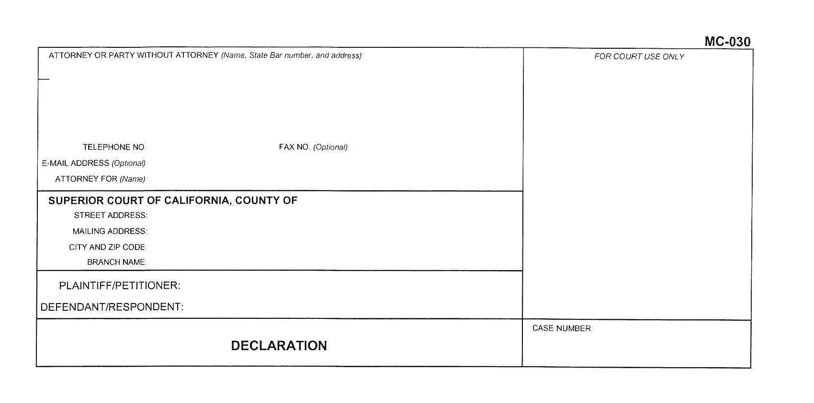

Slide 45
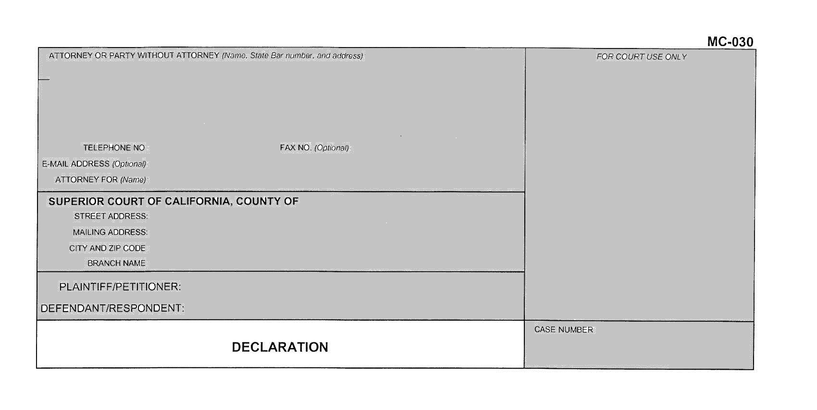

Slide 46
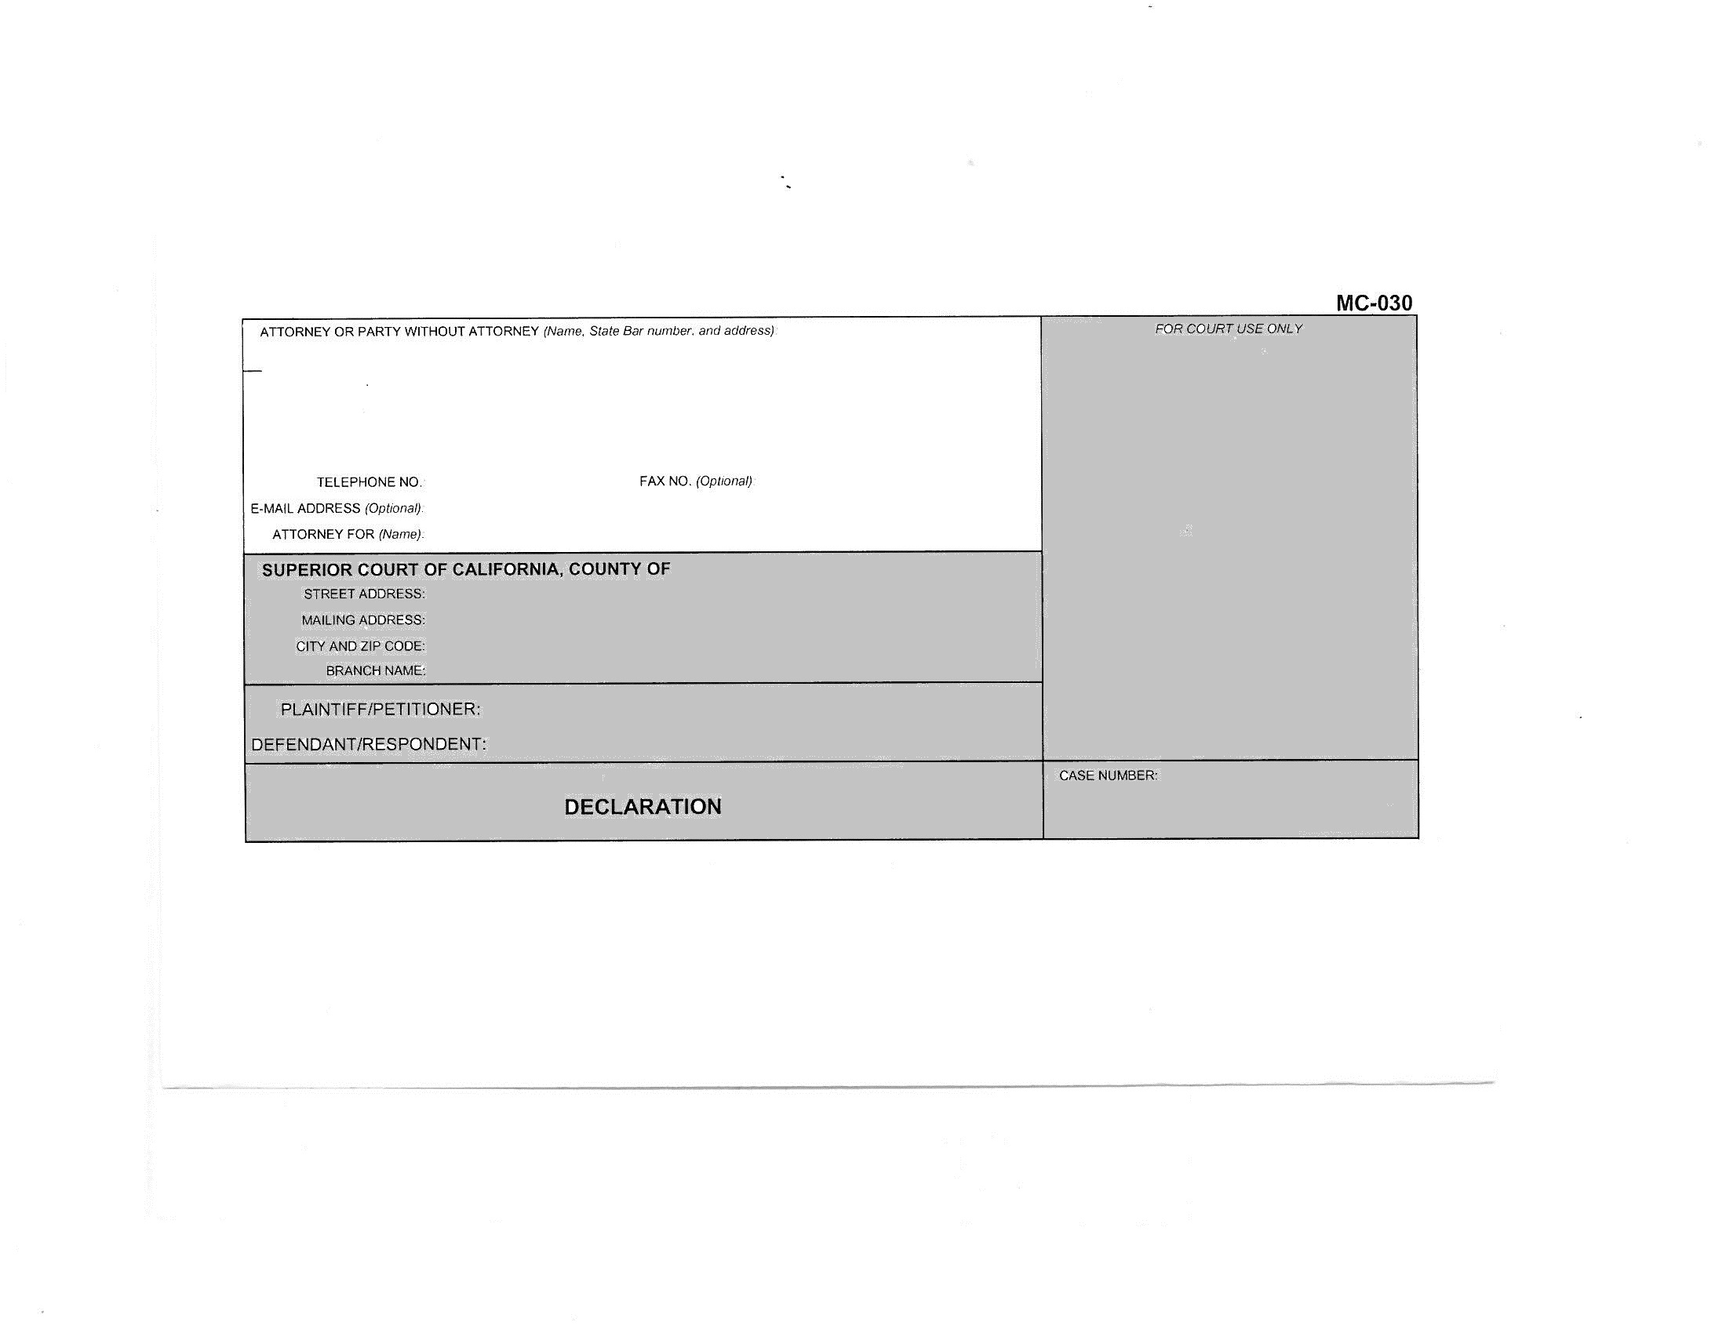

Slide 47
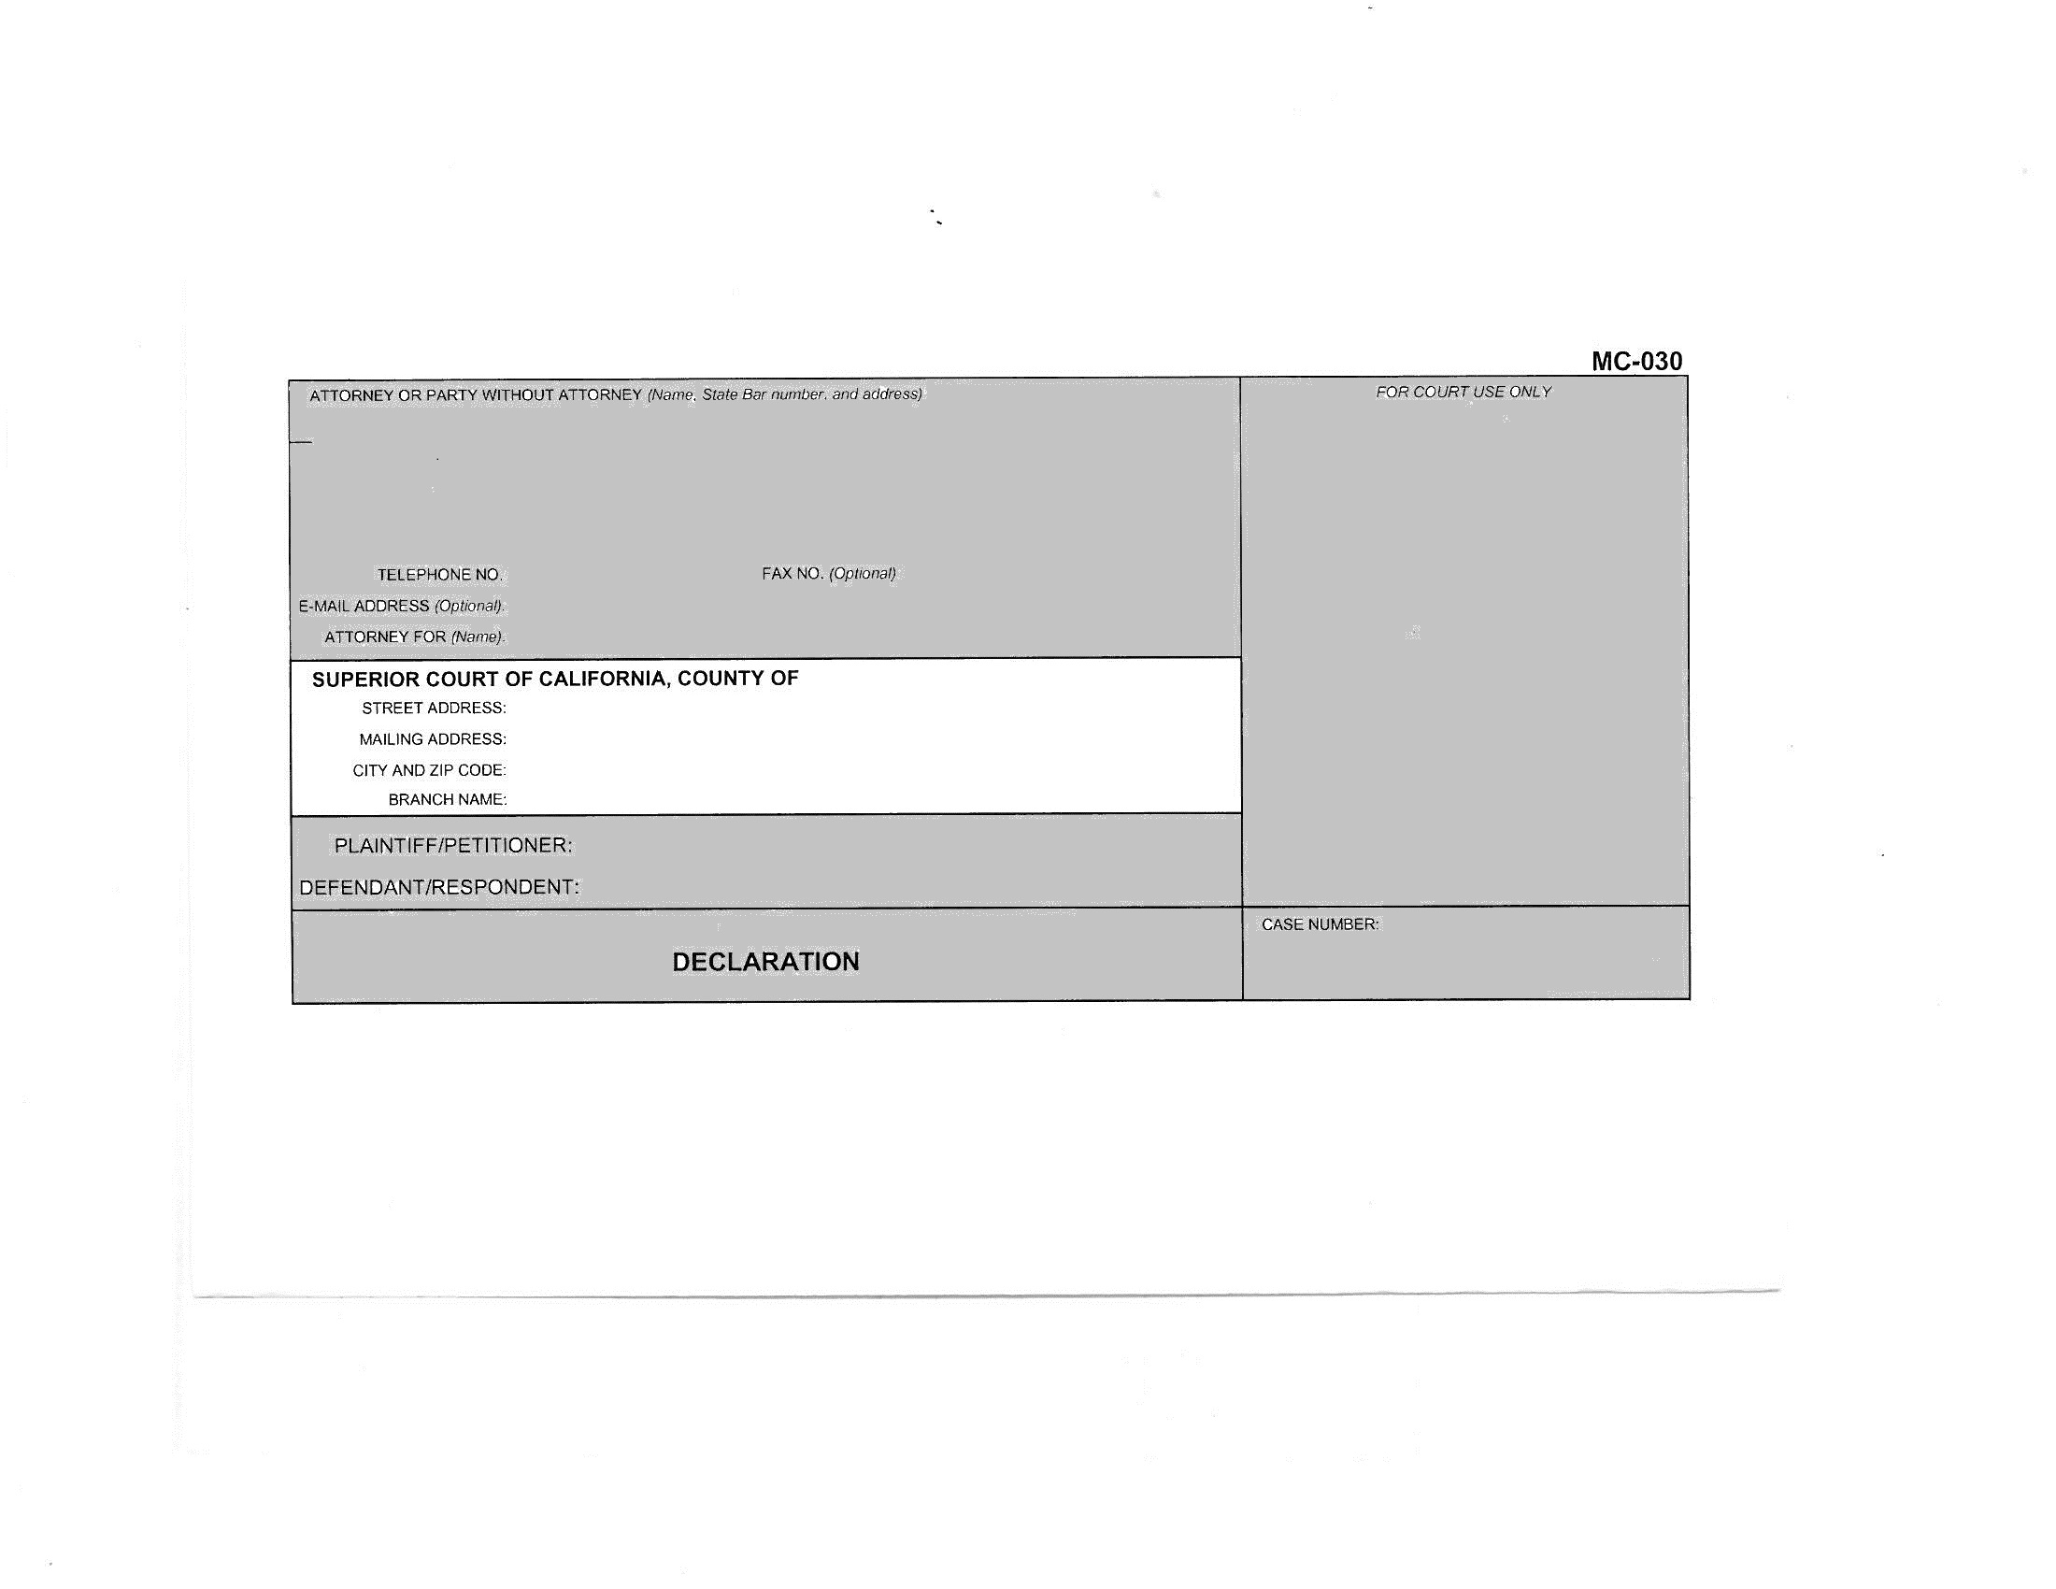

Slide 48
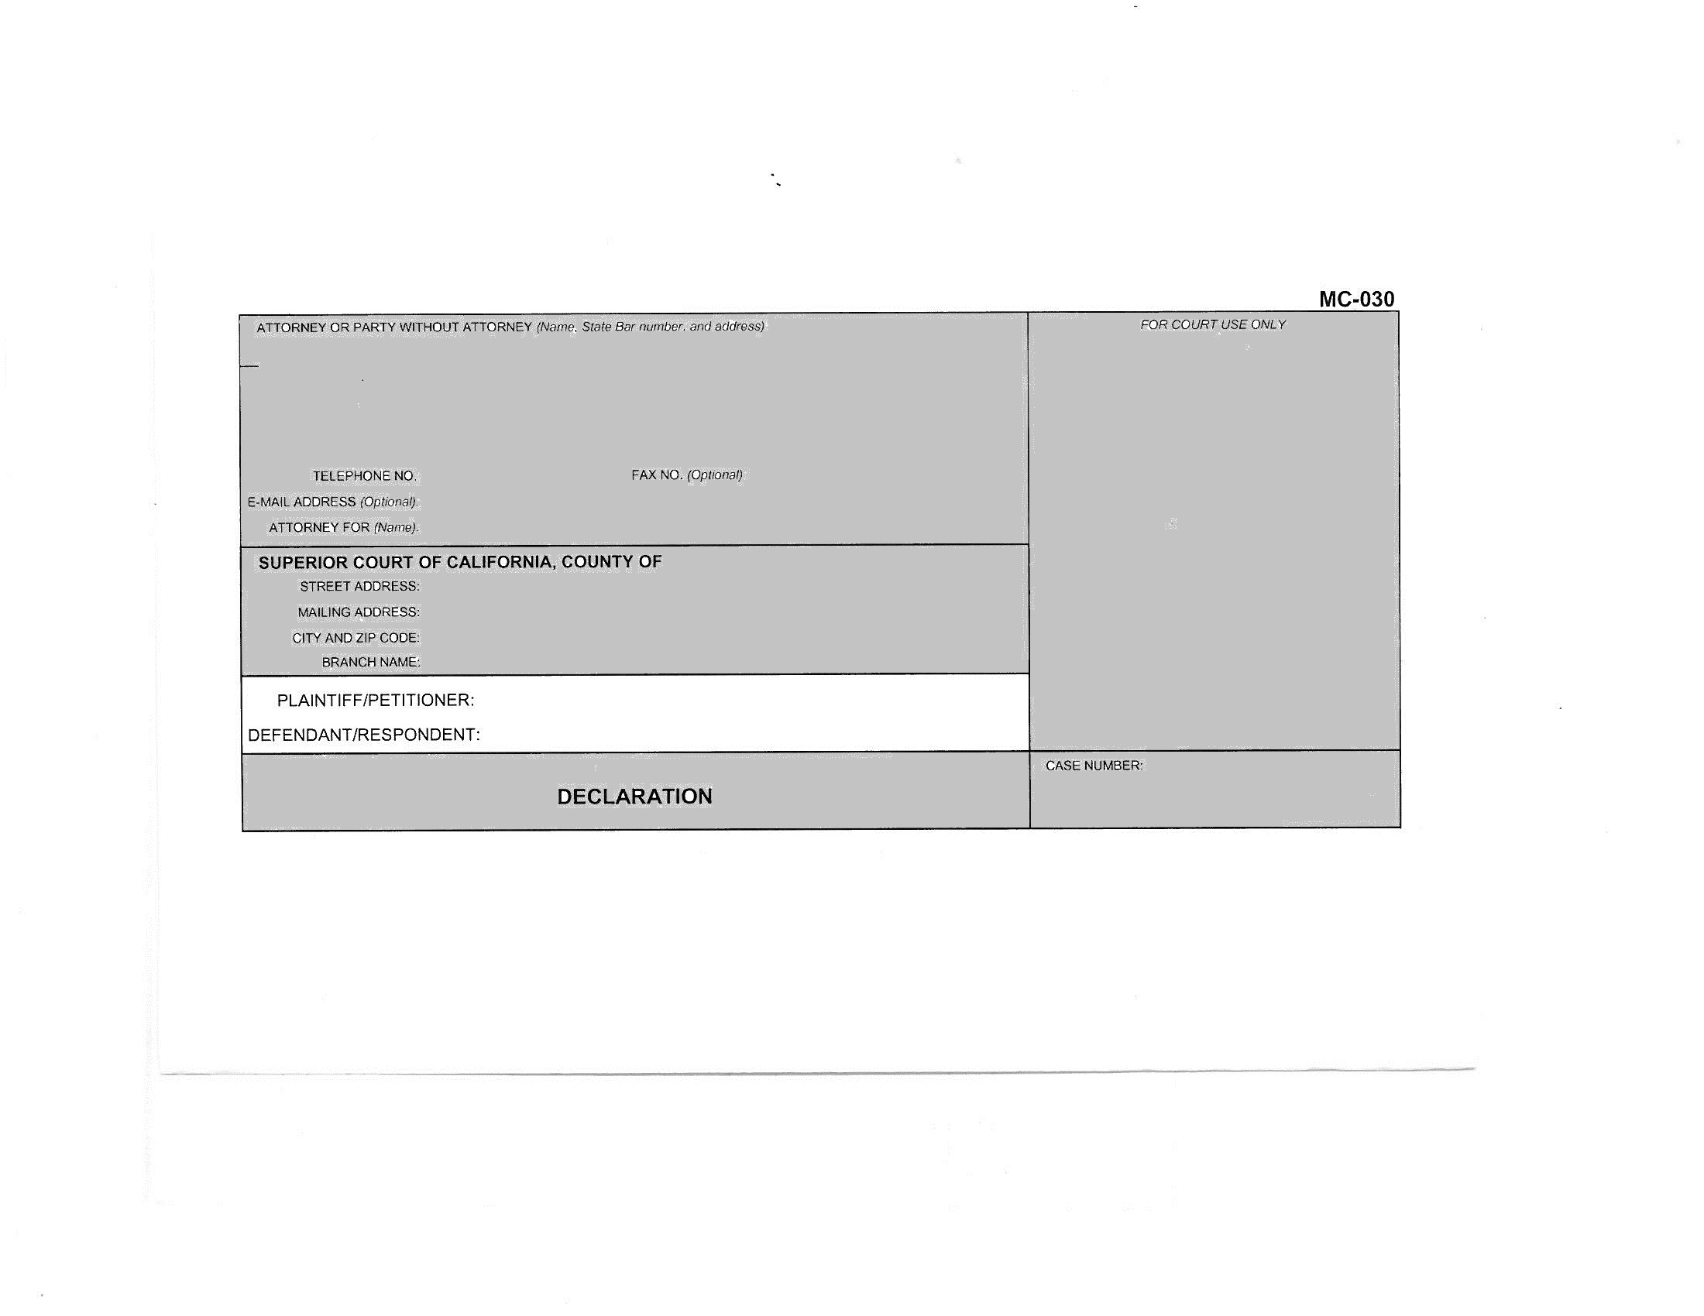

Slide 49
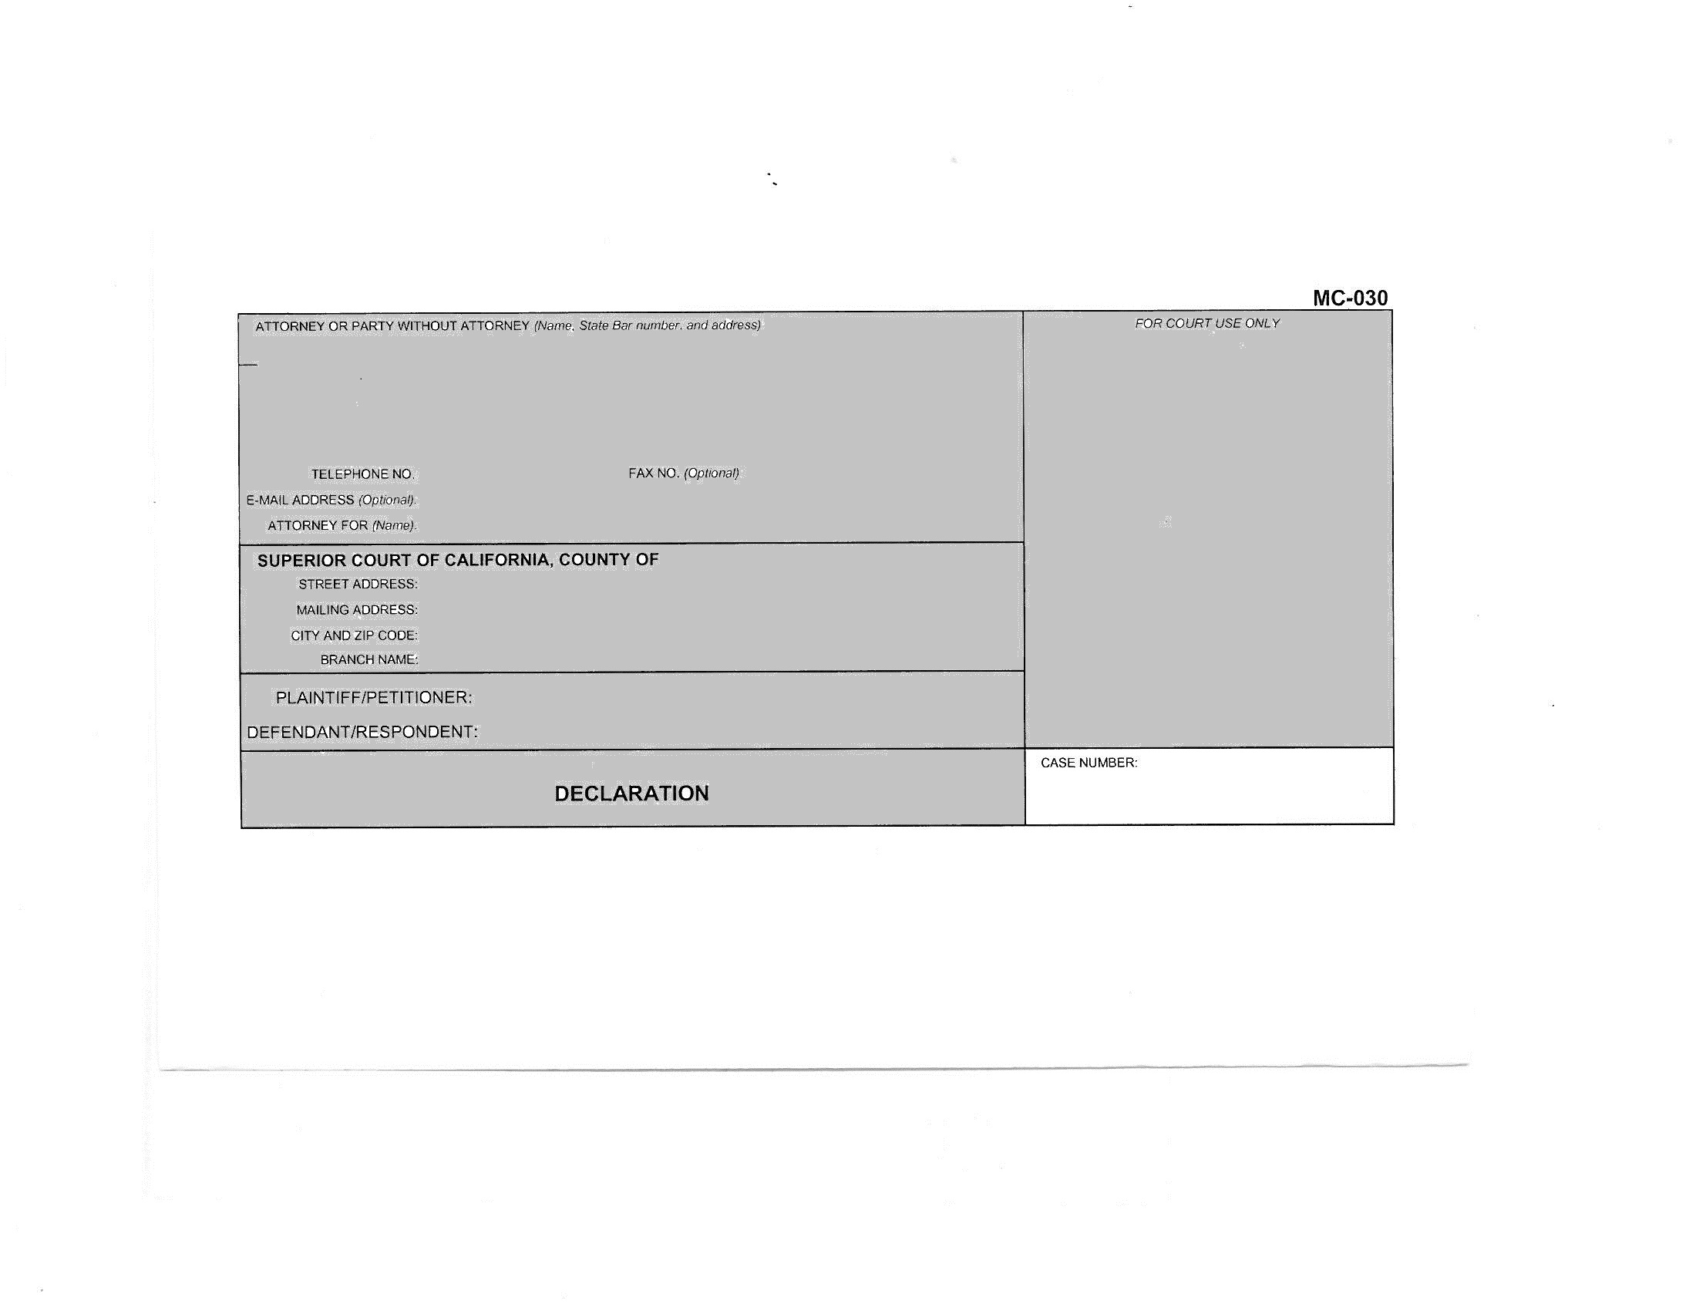

Slide 51
How to Write a Declaration for the Court

Slide 52
provide FACTS, not opinions or conclusions

Slide 53
answer the question:
How do you know that?

Slide 54
outline your declaration

Slide 55
short and to the point

Slide 56
personal knowledge

Slide 57
events in order, starting with the most recent

Slide 58
proofread

Slide 60
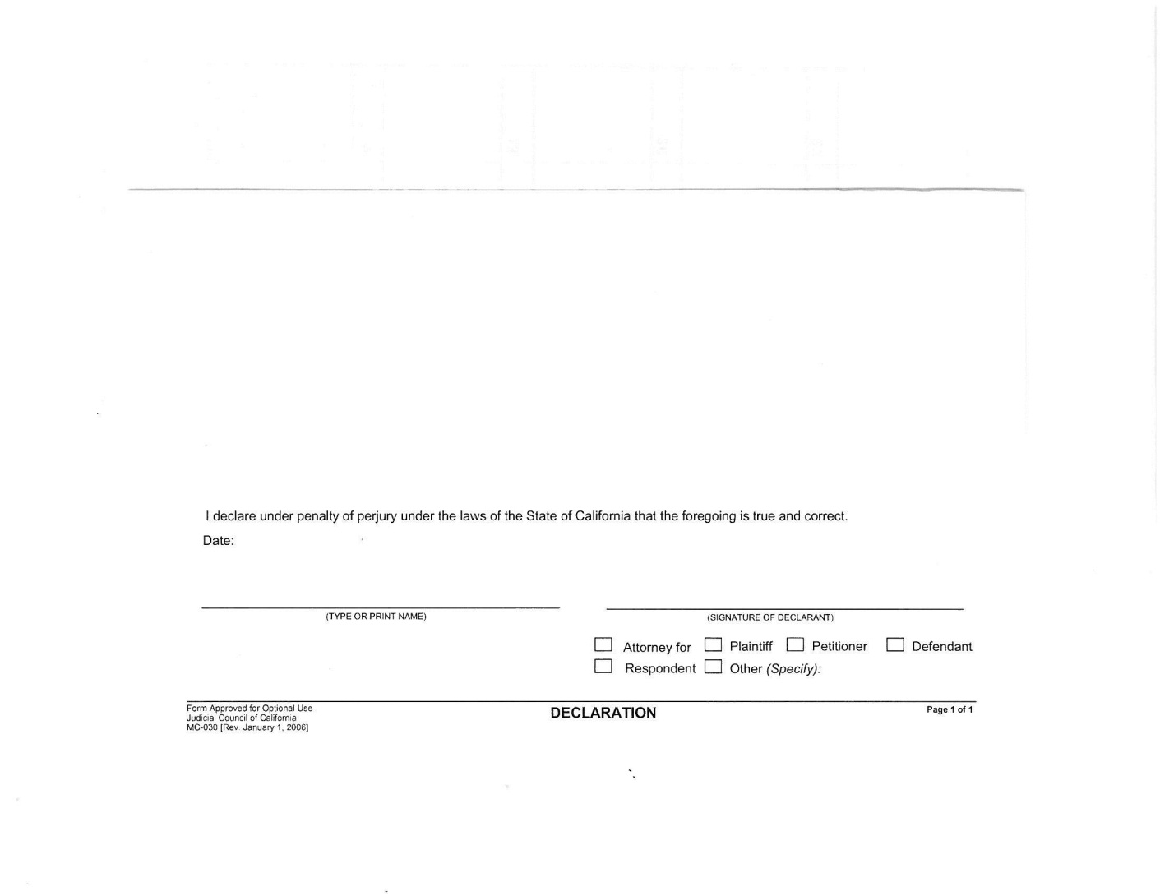

Slide 61
“I declare under penalty of perjury …”

Slide 62
write your declaration

Slide 63
fillable forms:
www.courts.ca.gov/documents/mc030.pdf
(for a declaration filed by itself)
www.courts.ca.gov/documents/mc031.pdf
(for a declaration attached to another filing)

Slide 64
blank pleading paper:
www.occourts.org/forms/local/l930.pdf

Slide 65
Thank you for writing a declaration that will be helpful to the Court.

