Slide 1
How to Prepare a Stipulation and Order Waiving Unassigned Arrears, and a Request for Order for the Stipulation.
SUPERIOR COURT OF CALIFORNIA
COUNTY OF ORANGE
SELF-HELP CENTER/
FAMILY LAW FACILITATOR OFFICE

Slide 2
This document can assist you in completing the necessary paperwork for filing a Stipulation and Order Waiving Unassigned Arrears, and a Request for Order regarding the Stipulation.
It is recommended that you print a copy of this document first, then use the step-by-step instructions to complete the necessary forms.
You can then use the following links to go directly to the online version of the form, where you can type in the required information and then print the completed forms:
Stipulation and Order Waiving Unassigned Arrears: http://www.courts.ca.gov/documents/fl626.pdf
Request for Order: http://www.courts.ca.gov/documents/fl300.pdf
Declaration Regarding Address Verification: http://www.courts.ca.gov/documents/fl334.pdf
Proof of Service by Mail: http://www.courts.ca.gov/documents/fl335.pdf
Proof of Personal Service: http://www.courts.ca.gov/documents/fl330.pdf
Once you have completed and signed the appropriate forms, you can file them at the Lamoreaux Justice Center, Room 706 (on the 7th floor).
If you would like someone to review your finished documents before filing them, you can bring them to the Self-Help Center at the Lamoreaux Justice Center.
If the County of Orange, Child Support Services (CSS) is involved in the case, you will need to obtain from CSS your case balance history and your case balance detail. You can get these documents at the CSS office at 1055 N. Main St., Santa Ana CA 92701, or at the branch office located on the 5th floor of the Lamoreaux Justice Center located at 341 The City Drive South, Orange CA 92863

Slide 3
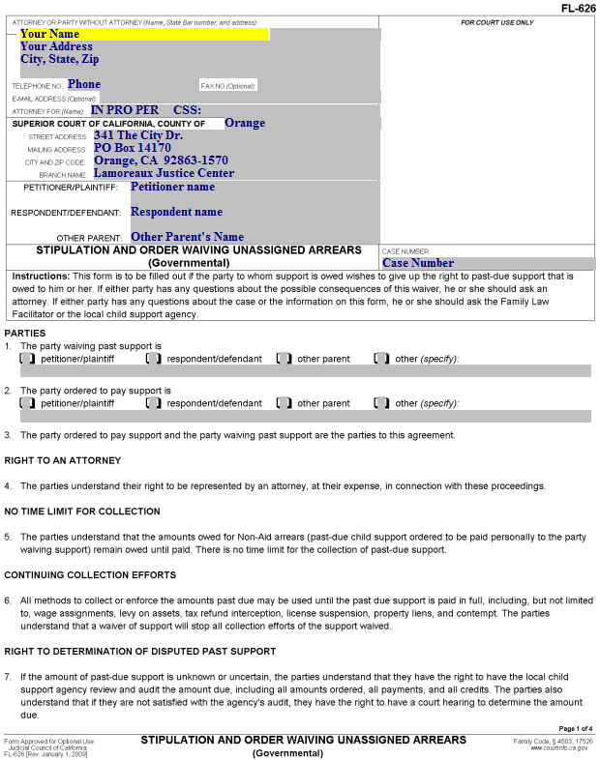
Stipulation and Order Waiving Unassigned Arrears (page 1)
Enter your name, address and phone number here.

Slide 4
Stipulation and Order Waiving Unassigned Arrears (page 1)
Enter “IN PRO PER” (meaning you are self-represented) on this line.
If CSS is involved in your case, enter your CSS case number here.

Slide 5
Stipulation and Order Waiving Unassigned Arrears (page 1)
Enter the Court’s information as shown here.

Slide 6
Stipulation and Order Waiving Unassigned Arrears (page 1)
Enter the Petitioner’s name, the Respondent’s name, and (if applicable) the Other Parent’s name here. Note: This information should match the original Complaint.

Slide 7
Stipulation and Order Waiving Unassigned Arrears (page 1)
Enter the court’s case number here.

Slide 8
Stipulation and Order Waiving Unassigned Arrears (page 1)
Parties
Item 1. Check the box representing the person who is waiving the unassigned arrears and enter her/his name in the space provided.

Slide 9
Stipulation and Order Waiving Unassigned Arrears (page 1)
Parties
Item 2. Check the box representing the person who is receiving the waiver of unassigned arrears and enter her/his name in the space provided.

Slide 10
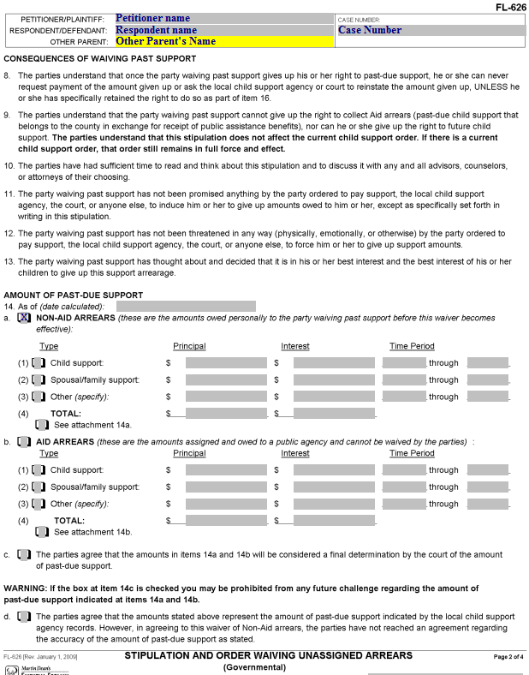
Stipulation and Order Waiving Unassigned Arrears (page 2)
Item 14. You will need to refer to your CSS Case Balance Detail to complete this section.
Enter the date on the CSS Case Balance Detail here.

Slide 11
Stipulation and Order Waiving Unassigned Arrears (page 2)
Item 14. You will need to refer to your CSS Case Balance Detail to complete this section.
Check this box if there are non-aid arrears owed to the custodial parent. (Usually designated as “NAA” on the CSS Case Balance Detail).

Slide 12
Stipulation and Order Waiving Unassigned Arrears (page 2)
Item 14. You will need to refer to your CSS Case Balance Detail to complete this section.
a. Non-Aid Arrears. For each type of support owed (as shown on the CSS Case Balance Detail), check the appropriate box and enter the amount of the principal and the amount of interest.
For the Time period, you can enter the date on the CSS Case Balance Detail in the box after “through.” If you know the date the arrears began to accumulate, you can enter it in the box before “through.”
Enter the total of the Principal and Interest columns on the TOTAL line.

Slide 13
Stipulation and Order Waiving Unassigned Arrears (page 2)
Item 14.
b. Aid Arrears. If part of the arrears is owed to CSS, check this box and complete this section in the same way you completed section a.

Slide 14
Stipulation and Order Waiving Unassigned Arrears (page 2)
Item 14.
c. Check this box if you and the other party agree that the amounts in 14a and 14b should be considered a final determination by the court of the amount of past due support. This will prohibit any future challenge regarding the amount of past due support.

Slide 15
Stipulation and Order Waiving Unassigned Arrears (page 2)
Item 14.
d. If you don’t check the box for c, you will need to check this box.

Slide 16
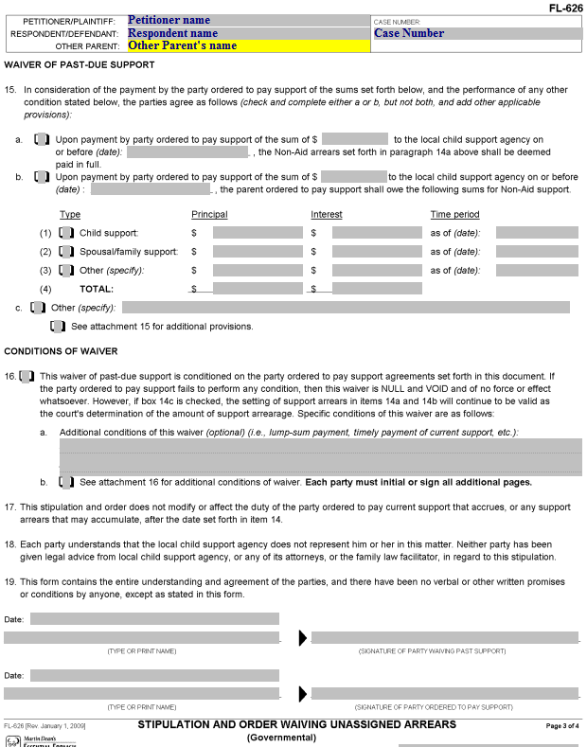
Stipulation and Order Waiving Unassigned Arrears (page 3)
Enter the parties’ names and the case number.

Slide 17
Stipulation and Order Waiving Unassigned Arrears (page 3)
Item 15. You will need to reach an agreement with the other party about any conditions for the waiver of arrears. You can use 15a or 15b to specify a lump-sum payment that will result in the waiver of all (15a) or part (15b) of the unassigned arrears.
If the other party is willing to waive all unassigned arrears without requiring a payment, check 15c and enter “All unassigned arrears are waived.”
If you have additional provisions, check the box under the 15c line and attach the additional pages.

Slide 18
Stipulation and Order Waiving Unassigned Arrears (page 3)
Item 16. Conditions of Waiver.
If there is current support ordered, check the box for Item 16. This states that the waiver is conditioned on the ordered support being paid in a timely fashion.
If there are additional conditions to the waiver, you can specify them in 16a and, if necessary, on an additional page or pages attached to this document (check 16b if this is the case). Note that all additional pages must be initialed or signed by all parties.

Slide 19
Stipulation and Order Waiving Unassigned Arrears (page 3)
Item 19.
The party waiving the unassigned arrears will date, print their name, and sign here.

Slide 20
Stipulation and Order Waiving Unassigned Arrears (page 3)
Item 19.
The party receiving the waiver of unassigned arrears will date, print their name, and sign here.
Keep this document together with the Case Balance Detail and Case Balance History.

Slide 21
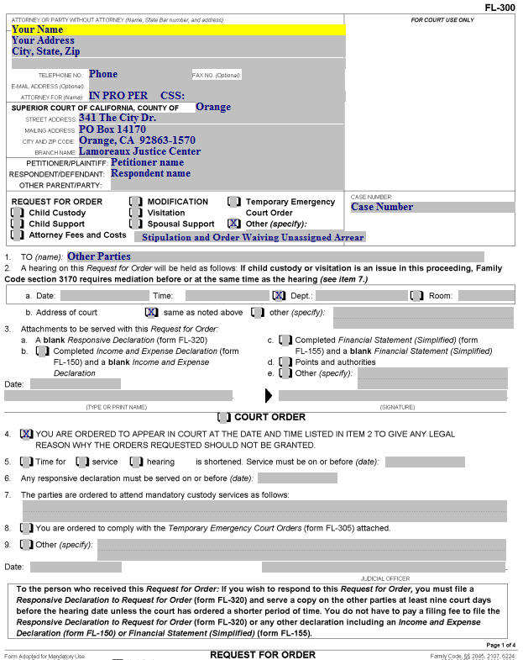
Request for Order (page 1)
Enter your name, address and phone number.

Slide 22
Request for Order (page 1)
Enter “IN PRO PER” here. This means you are representing yourself, and do not have an attorney.

Slide 23
Request for Order (page 1)
If the Department of Child Support Services (County of Orange) is involved in your case, enter “CSS:” followed by your DCSS case number here.

Slide 24
Request for Order (page 1)
Enter this information about the Court here.

Slide 25
Request for Order (page 1)
The Petitioner’s Name, Respondent’s name, and (if appropriate) the Other Parent’s name go here.
Note: Use another filed document for this. The case caption does not change. If you are the Respondent named in the original filing document in the case, you will always be the Respondent, even if you are the one filing the Request for Order.

Slide 26
Request for Order (page 1)
Enter your court case number here.

Slide 27
Request for Order (page 1)
Check the box for “Other” and enter “Stipulation and Order Waiving Unassigned Arrears” here.

Slide 28
Request for Order (page 1)
Item 1. Enter the name(s) of the other party(ies). If CSS is involved in the case, “County of Orange” will be a party, together with the Other Parent’s name (and the words “and his/her attorney of record” if the other parent has an attorney)

Slide 29
Request for Order (page 1)
Item 2a. Do not enter anything here. When you file the document, the date, time and place of the hearing on the Request will be shown here (after it is filed).

Slide 30
Request for Order (page 1)
Item 2b. Check this box.

Slide 31
Request for Order (page 1)
Enter the date and print your name.

Slide 32
Request for Order (page 1)
After the document is printed, sign it here.

Slide 33
Request for Order (page 1)
Item 4. Check this box and go to the next page.

Slide 34
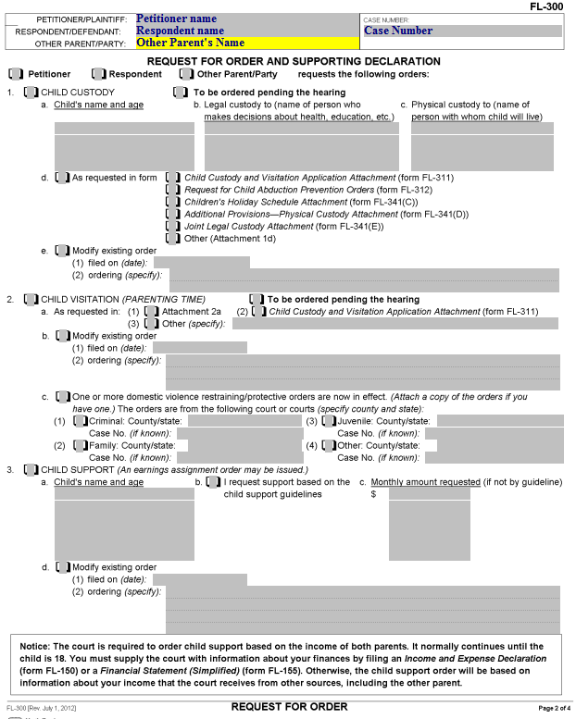
Request for Order (page 2)
Enter this information, which will be the same for each page (Petitioner’s name, Respondent’s name, Other Parent’s name, if applicable, and the Court case number).

Slide 35
Request for Order (page 2)
Check the box identifying the party filing the Request for Order.
Go to the next page.

Slide 36
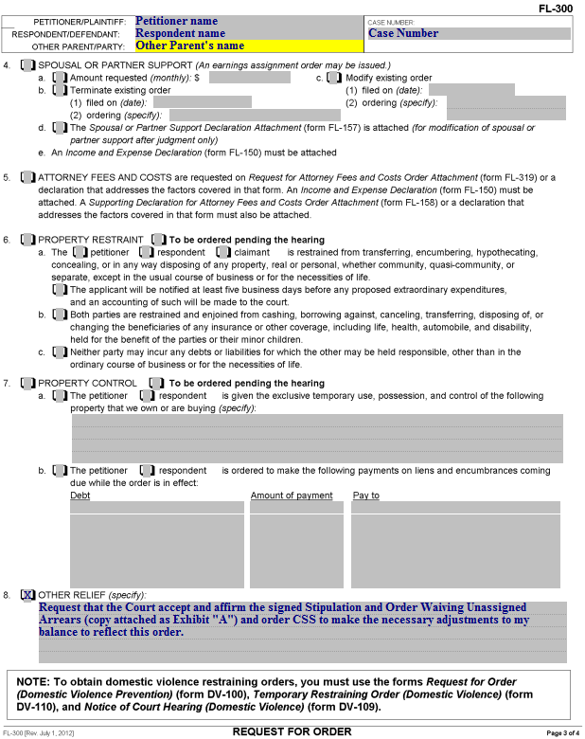
Request for Order (page 3)
Item 8. Enter this language for “Other Relief.” (A copy of the Stipulation and Order Waiving Unassigned Arrears will be attached as “Exhibit A”)

Slide 37
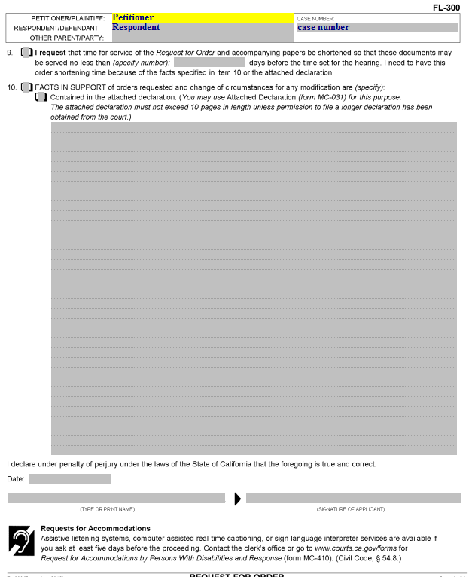
Request for Order (page 4)
Item 10. Check the box for this item. Facts supporting the request can be written here or on a separate declaration page. If you use a separate declaration page, check the box for “Contained in the attached declaration.”

Slide 38
Request for Order (page 4)
Enter the date, your printed name and your signature here.

Slide 39
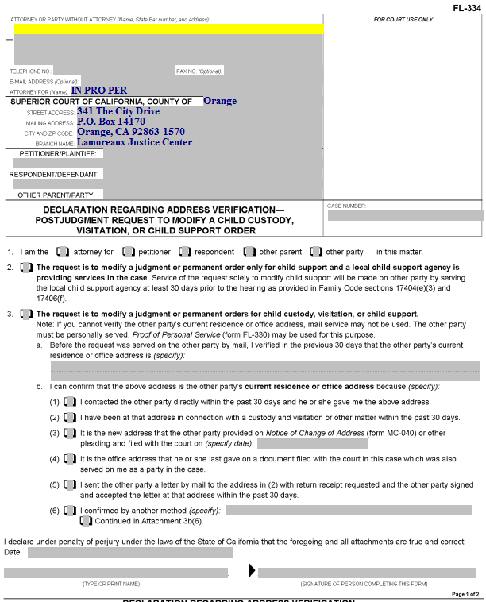
Declaration Regarding Address Verification
This form is required if you are having the other party served by mail after a Judgment has been entered. It shows the court you know the address of the other person to whom you will serve the documents by mail.

Slide 40
Declaration Regarding Address Verification
Enter your information here, name, complete address, & telephone number.

Slide 41
Declaration Regarding Address Verification
Enter the Petitioner, Respondent and Other Parent (as on the original document) here.

Slide 42
Declaration Regarding Address Verification
Enter the Court case number here.

Slide 43
Declaration Regarding Address Verification
Item 1. Check the box that represents who you are in the case.

Slide 44
Declaration Regarding Address Verification
Item 2. Check this box if your Request for Order is regarding child support only and Child Support Services (County of Orange) is involved in your case.

Slide 45
Declaration Regarding Address Verification
Item 3. Check this box if you don’t check box 2.

Slide 46
Declaration Regarding Address Verification
Item 3.a. Enter the address of the party who is being served by mail here.

Slide 47
Declaration Regarding Address Verification
Item 3.b. Check one of these boxes to indicate how you know the address is correct. If you check (6), describe how you know the address in the space provided. If you need more space, attach a page labeled “Attachment 3b(6).”

Slide 48
Declaration Regarding Address Verification
You will enter the date, print your name, and provide your signature here.

Slide 49
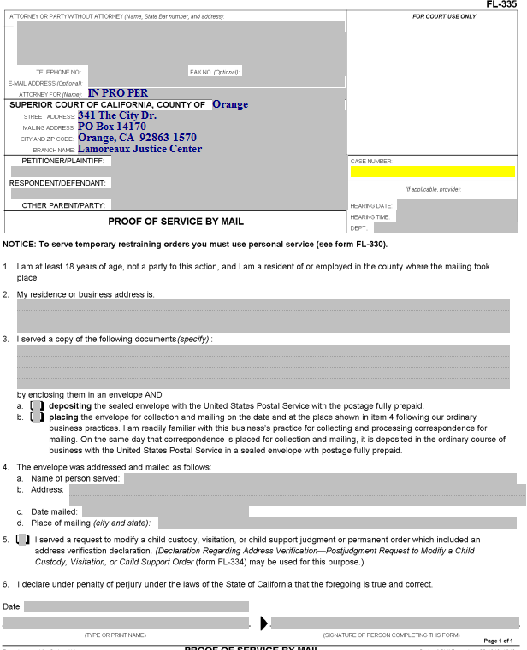
Proof of Service by Mail
Someone over the age of 18 who is not a party to the case needs to perform your actual service (i.e., placing a copy of the documents you filed into a Post Office mail box) for you. California law does not permit you to do your own service.
That person will complete the form, which you must will then file with the court.

Slide 50
Proof of Service by Mail
Enter your information, name, address & telephone number, the party names and the case number.

Slide 51
Proof of Service by Mail
Enter the date, time and courtroom (Dept.) for the hearing here.

Slide 52
Proof of Service by Mail
Item 2. The address of the person who does your service for you (the server) is entered here (by the server).

Slide 53
Proof of Service by Mail
Item 3. Enter the name(s) of the actual document(s) served here (e.g., Request for Order and Supporting Declaration, Income and Expense Declaration, blank responsive pleadings).

Slide 54
Proof of Service by Mail
Item 3.a and b. The server will check one of these two boxes, depending on how the documents are mailed.

Slide 55
Proof of Service by Mail
Item 4.a. Enter the name of the person to whom the documents were mailed here.

Slide 56
Proof of Service by Mail
Item 4.b. Enter the address that the documents were mailed to here.

Slide 57
Proof of Service by Mail
Item 4.c. Your server enters the city and state where the documents were mailed here.

Slide 58
Proof of Service by Mail
Item 4.d. Your server enters the city and state where the documents were mailed here.

Slide 59
Proof of Service by Mail
Item 5. This box is checked if a Declaration Regarding Address Verification was completed and filed. A copy of that Declaration should be attached to the Proof of Service.

Slide 60
Proof of Service by Mail
The person who does the mailing dates, prints their name, and signs the proof of service here.
The Proof of Service must then be filed with the Court.

Slide 61
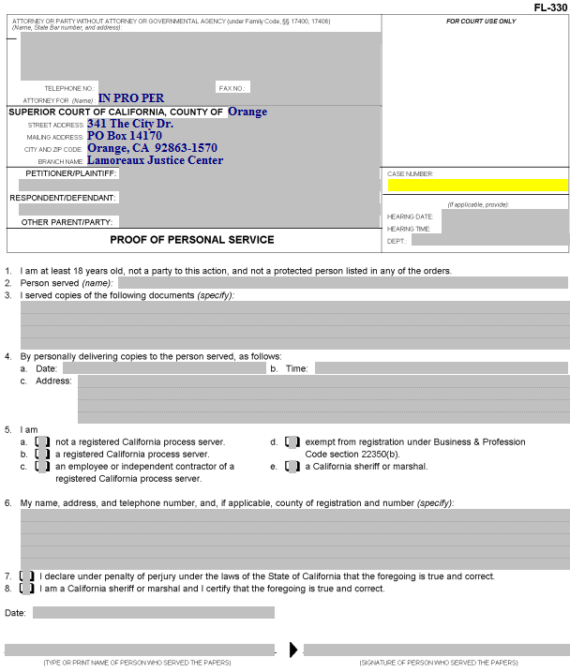
Proof of Personal Service
Someone over the age of 18 who is not a party to the case needs to do your actual service for you.
That person will complete this form, which you must then have filed with the court.

Slide 62
Proof of Personal Service
Enter your information, name, address, & telephone number, the party names and the case number.

Slide 63
Proof of Personal Service
Enter the date, time and place of the hearing here.

Slide 64
Proof of Personal Service
Item 2. The person doing the service enters the name of the person served here.

Slide 65
Proof of Personal Service
Item 3. Enter the name of the documents being served (e.g., Request for Order, Income and Expense Declaration, blank responsive pleadings).

Slide 66
Proof of Personal Service
Item 4. The person doing the service enters the date, time, and address where the other party was served here.

Slide 67
Proof of Personal Service
Item 5. The category of the person performing the service is indicated by checking the appropriate box (usually “a”).

Slide 68
Proof of Personal Service
Item 6. The person doing the service enters his or her name, address and telephone number here.

Slide 69
Proof of Personal Service
Item 7. If the server is not a California sheriff or marshal, this box needs to be checked.

Slide 70
Proof of Personal Service
The date, name of the person performing the service and his/her signature goes here.

Slide 71
Next Steps
After you have completed all of your documents, you will need to make copies, as follows:
The original is filed with the court, including a separate original of the Stipulation and Order Waiving Unassigned Arrears (with a copy attached to the Request for Order as well).
One copy is for your records.
Another copy is for the other party in the case.
If Child Support Services is involved, you will need an additional copy to be served on this agency.
If the other party has an attorney of record, you will need an additional copy to be served on the attorney.
If you would like your documents reviewed prior to filing, you can bring them to the Self-Help Center at Lamoreaux Justice Center.
You will file your documents in the Clerk’s Office at the Lamoreaux Justice Center (7th Floor, Room 706).

