Slide 1

How to Prepare Court Forms to Request a Judicial Adjustment of Arrearages Due to Incarceration or Involuntary Institutionalization
SUPERIOR COURT OF CALIFORNIA
COUNTY OF ORANGE
SELF-HELP CENTER/
FAMILY LAW FACILITATOR OFFICE

Slide 2
This document can assist you in completing the necessary paperwork for filing a Request for Judicial Adjustment of Arrearages Due to Incarceration or Involuntary Institutionalization.
You will need documentation of the dates you began your incarceration and were released from incarceration in order to proceed. This process is available for periods of incarceration that began on or after July 1, 2011, unless your support order contained a specific clause regarding suspension of child support during incarceration.
It is recommended that you print a copy of this document first, then use the step-by-step instructions to complete the necessary forms.
You can then use the following links to go directly to the online version of the form, where you can type in the required information and then print the completed forms:
  Request for Judicial Determination of Support Arrearages : http://www.courts.ca.gov/documents/fl676.pdf
  Declaration Regarding Address Verification: http://www.courts.ca.gov/documents/fl334.pdf
Once you have completed and signed the appropriate forms, you can file them at the Lamoreaux Justice Center, Room 706 (on the 7th floor).
If you would like someone to review your finished documents before filing them, you can bring them to the Self-Help Center at the Lamoreaux Justice Center.

Slide 3
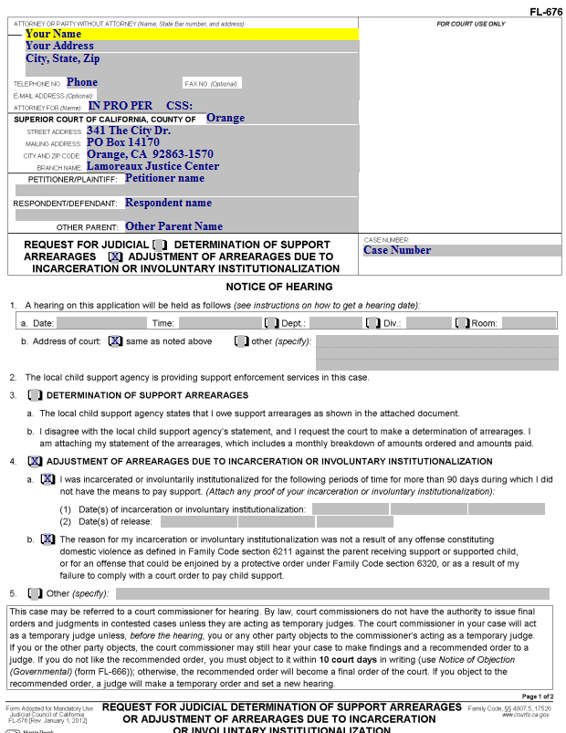
Request for Judicial Adjustment of Arrearages
(page 1)
Enter your address and phone number here.

Slide 4
Request for Judicial Adjustment of Arrearages
(page 1)
“IN PRO PER” means you do not have an attorney, but are representing yourself. Enter this on this line.
If Child Support Services is involved, you will have a CSS case number, which should be entered here.

Slide 5
Request for Judicial Adjustment of Arrearages
(page 1)
Enter this information on the form.

Slide 6
Request for Judicial Adjustment of Arrearages
(page 1)
Enter the Petitioner’s Name, Respondent’s name, and (if appropriate) the Other Parent’s name here.
Note: Use another filed document for this. The case caption does not change. If you are the Respondent named in the original filing document in the case, you will always be the Respondent, even if you are the one filing the Request.

Slide 7
Request for Judicial Adjustment of Arrearages
(page 1)
Enter your court case number here.

Slide 8
Request for Judicial Adjustment of Arrearages
(page 1)
Check this box.

Slide 9
Request for Judicial Adjustment of Arrearages
(page 1)
Check these boxes.

Slide 10
Request for Judicial Adjustment of Arrearages
(page 1)
Enter the date(s) of incarceration/ institutionalization on line (1) and the date(s) of release on line (2).

Slide 11
Request for Judicial Adjustment of Arrearages
(page 1)
Check this box. Your incarceration/ institutionalization can not have been for the reasons stated here.

Slide 12
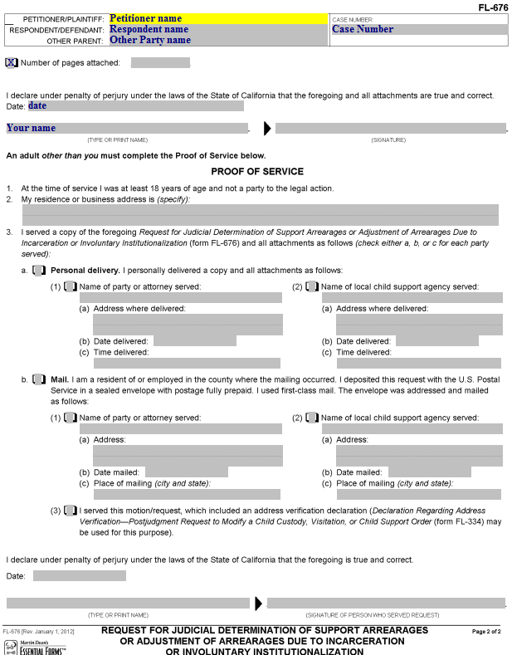
Request for Judicial Adjustment of Arrearages
(page 2)
Enter the Petitioner’s name, the Respondent’s name, the Other Parent’s name (if applicable) and the Case number here.

Slide 13
Request for Judicial Adjustment of Arrearages
(page 2)
Enter the date, your name, and (after printing) your signature.

Slide 14
Request for Judicial Adjustment of Arrearages
(page 2)
Proof of Service
Before you file this document, you will need to have the local child support agency and the other party served with a copy (including attachments).
California law does not allow you to perform the service yourself. You must have someone over the age of 18 who is not a party in the case serve the documents for you. That person (the server) will complete the included Proof of Service on this document AFTER the service of the copies was performed.

Slide 15
Request for Judicial Adjustment of Arrearages
(page 2)
Proof of Service
The server will provide his/her residence or business address here.

Slide 16
Request for Judicial Adjustment of Arrearages
(page 2)
Proof of Service
If the server personally delivered the documents to the other parties, he/she will check this box and provide the information in this section.

Slide 17
Request for Judicial Adjustment of Arrearages
(page 2)
Proof of Service
If the server mailed the documents to the other parties, he/she will check this box and provide the information in this section, including item (3), and you will also need to complete the Declaration Regarding Address Verification.

Slide 18
Preparing your supporting documents
You will need to provide evidence of all payments you have made for your support payments.
After you have gathered your documents, arrange them in chronological order, and make one copy on 8.5” x 11” paper. This will become your original for filing purposes.

Slide 19
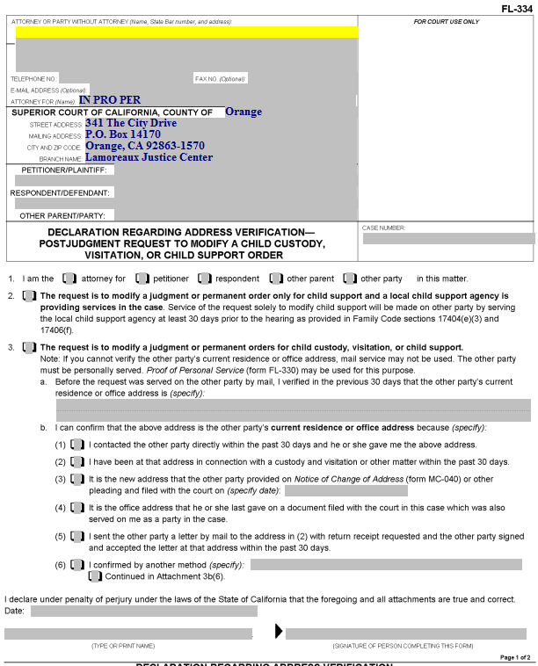
Declaration Regarding Address Verification
This form shows the court you know the address of the person to whom you will be mailing a copy of the Service Documents.
It is required for all Proofs of Service by Mail for documents served after Judgment is entered in a case.

Slide 20
Declaration Regarding Address Verification
Enter your information here.

Slide 21
Declaration Regarding Address Verification
Enter the Petitioner, Respondent and Other Parent (if on the original document) here.

Slide 22
Declaration Regarding Address Verification
Enter the Court case number here.

Slide 23
Declaration Regarding Address Verification
Item 1. Check the box that represents who you are in the case.

Slide 24
Declaration Regarding Address Verification
Item 2. Check this box if your Request for Order is regarding child support only and Child Support Services (County of Orange) is involved in your case.

Slide 25
Declaration Regarding Address Verification
Item 3. Check this box if you don’t check box 2.

Slide 26
Declaration Regarding Address Verification
Item 3.a. Enter the address of the party who is being served by mail here.

Slide 27
Declaration Regarding Address Verification
Item 3.b. Check one of these boxes to indicate how you know the address is correct. If you check (6), in the space provided, describe how you know the address. If you need more space, attach a page labeled “Attachment 3b(6).”

Slide 28
Declaration Regarding Address Verification
Enter the date, print your name, and provide your signature here.

Slide 29
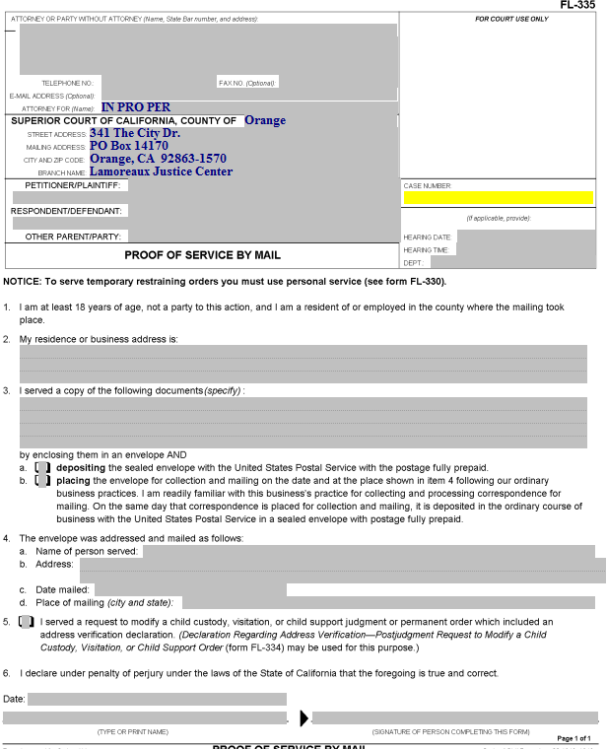
Proof of Service by Mail
Someone over the age of 18 who is not a party to the case needs to perform your actual service (i.e., placing a copy of the documents you filed into a Post Office mail box) for you. California law does not permit you to do your own service.
That person (the “server”) will complete this form, which you must then have filed with the court.

Slide 30
Proof of Service by Mail
Enter your information, the party names and the case number.

Slide 31
Proof of Service by Mail
Enter the date, time and courtroom (Dept.) for the hearing here.

Slide 32
Proof of Service by Mail
Item 2. The person who mails the documents for you (the “server”) will enter their address here.

Slide 33
Proof of Service by Mail
The address of the person who does your service for you (the server) is entered here (by the server)

Slide 34
Proof of Service by Mail
Item 3. Enter the name(s) of the actual document(s) served here (e.g., Request for Order and Supporting Declaration, Income and Expense Declaration, blank responsive pleadings).

Slide 35
Proof of Service by Mail
Item 3.a and b. The server will check one of these two boxes, depending on how the documents are mailed.

Slide 36
Proof of Service by Mail
Item 4.a. Enter the name of the person to whom the documents were mailed here.

Slide 37
Proof of Service by Mail
Item 4.b. Enter the address that the documents were mailed to here.

Slide 38
Proof of Service by Mail
Item 4.c. Your server enters the date on which the documents were mailed here.

Slide 39
Proof of Service by Mail
Item 4.d. Your server enters the city and state where the documents were mailed here.

Slide 40
Proof of Service by Mail
Item 5. This box is checked if a Declaration Regarding Address Verification was completed and filed. A copy of that Declaration should be attached to the Proof of Service.

Slide 41
Proof of Service by Mail
The server dates, prints their name, and signs the proof of service here.
The Proof of Service must then be filed with the Court.

Slide 42
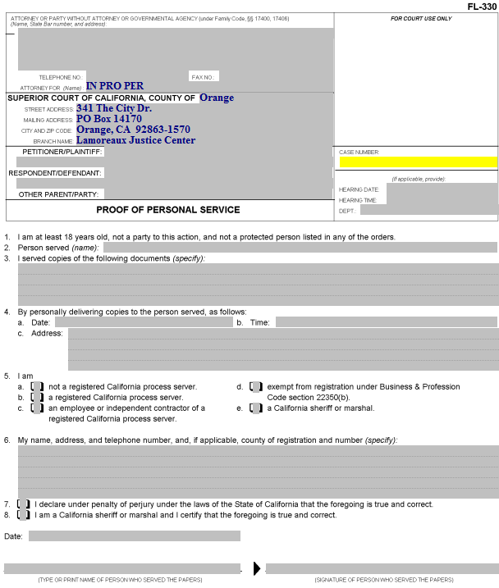
Proof of Personal Service
Someone over the age of 18 who is not a party to the case needs to do your actual service for you. California law does not permit you to do your own service.

Slide 43
Proof of Personal Service
Enter your information, the party names and the case number.

Slide 44
Proof of Personal Service
Enter the date, time and place of the hearing here.

Slide 45
Proof of Personal Service
Item 2. The server enters the name of the person served here.

Slide 46
Proof of Personal Service
Item 3. Enter the name of the documents being served (e.g., Request for Order, Income and Expense Declaration, blank responsive pleadings).

Slide 47
Proof of Personal Service
Item 4. The server enters the date, time, and address where the other party was served here.

Slide 48
Proof of Personal Service
Item 5. The category of the person performing the service is indicated by checking the appropriate box (usually “a”).

Slide 49
Proof of Personal Service
Item 6. The server enters her/his name, address and telephone number here.

Slide 50
Proof of Personal Service
Item 7. If the server is not a California sheriff or marshal, this box needs to be checked.

Slide 51
Proof of Personal Service
The server dates, prints his/her name, and provides a signature here.

Slide 52
Next Steps
After you have completed all of your documents, you will need to make copies, as follows:
The original is filed with the court.
One copy is for your records.
Another copy is for the other party in the case.
If Child Support Services is involved, you will need an additional copy to be served on this agency.
If the other party has an attorney of record, you will need an additional copy to be served on the attorney.
If you would like your documents reviewed prior to filing, you can bring them to the Self-Help Center at Lamoreaux Justice Center.
You will file your documents in the Clerk’s Office at the Lamoreaux Justice Center (7th Floor, Room 706).

