Slide 1

How to Prepare an Income and Expense Declaration
SUPERIOR COURT OF CALIFORNIA
COUNTY OF ORANGE
SELF-HELP CENTER/
FAMILY LAW FACILITATOR OFFICE

Slide 2
This document can assist you in completing an Income and Expense Declaration.
It is recommended that you print a copy of this document first, then use the step-by-step instructions to complete the form.
You can then use the following link to go directly to the online version of the form, where you can type in the required information and then print the completed forms:
  Income and Expense Declaration: http://www.courts.ca.gov/documents/fl150.pdf
Once you have completed and signed the form, you can file it at the Lamoreaux Justice Center, Room 706 (on the 7th floor).
If you would like someone to review your finished document before filing it, you can bring it to the Self-Help Center at the Lamoreaux Justice Center.

Slide 3
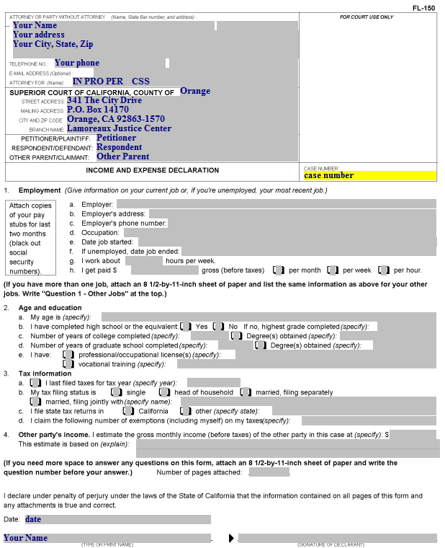
Income and Expense Declaration
Item 1.g. Enter the average number of hours you work per week.

Slide 4
Income and Expense Declaration
Item 1.h. If you are paid an hourly wage, enter it and check the “per hour” box. If you are paid a weekly or monthly salary, enter the gross amount (before deductions) you are paid and check the appropriate box.

Slide 5
Income and Expense Declaration
Item 2. Here you provide:
Item 2.1. Your age
Item 2.b. If you have completed high school (or the equivalent, such as GED), and if not, the highest grade you completed.
Item 2.c. The number of years of college completed and any degrees
Item 2.d. Graduate school information
Item 2.e. Professional/occupational licenses and/or vocational training.

Slide 6
Income and Expense Declaration
Item 3. Here you provide:
3.a. The last year for which you filed your income taxes (e.g., if you filed in 2012, it was for the year 2011).
3.b. Your tax filing status for the current year.
3.c. If you live in California, check the box for “California.” If not, check “other” and enter the state where you will file taxes for this year.
3.d. If you are single, your exemptions will be one. If you are married or head of household, your exemptions will be yourself and your spouse and the children living with you.

Slide 7
Income and Expense Declaration
Item 4. Here you provide:
The other party’s income.
Unless you know the other party’s income, enter “unknown.” if you put an amount in this item, you then have to state how you know that amount.

Slide 8
Income and Expense Declaration
Enter the date and your name, then sign this page after it is printed.

Slide 9
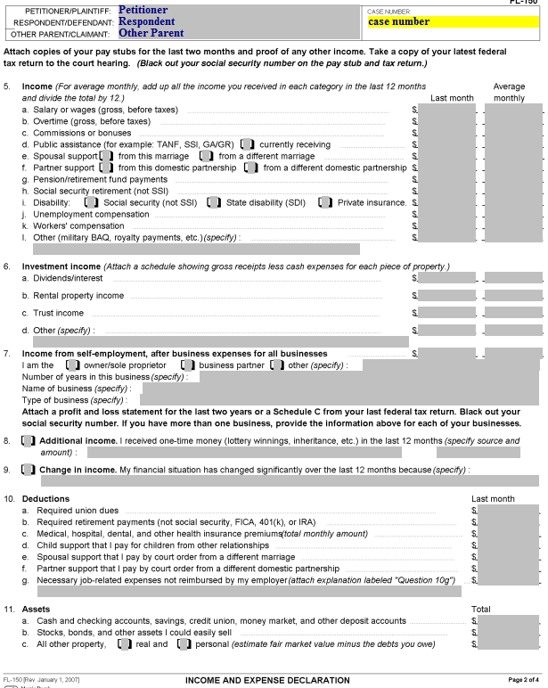
Income and Expense Declaration (page 2)
Item 5. This column labeled “Last Month: is for your income received during the preceding month (e.g., if it’s June 14, you would put in May’s information) The column labeled “Average Monthly” is for your average income per month over the last 12 months.
If your income for any of the line items has remained the same, the numbers in both columns would be the same.
If you did not have this income for all 12 months, divide the total income you received for the last 12 months by 12 to determine the average monthly income.

Slide 10
Income and Expense Declaration (page 2)
Item 5.a. This line is for your salary or wages earned, before any deductions.

Slide 11
Income and Expense Declaration (page 2)
Item 5.b and c. These lines are for any overtime, commissions or bonuses you received in addition to the amount for line 5.a..

Slide 12
Income and Expense Declaration (page 2)
Item 5.d. This is for any public assistance you receive, including food stamps. If you are currently receiving aid, check the “currently receiving” box.

Slide 13
Income and Expense Declaration (page 2)
Item 5.e. This is for any spousal support you are receiving, from this marriage or a different marriage.
Item 5.f. Same as 5.e., but for domestic partnerships.

Slide 14
Income and Expense Declaration (page 2)
Item 5.g. Enter the amount you are receiving for any pension or retirement fund payments.
Item 5.h. Enter the amount you are receiving for Social Security retirement.

Slide 15
Income and Expense Declaration (page 2)
Item 5.i. Enter the amount you are receiving (before deductions) for disability. Check the appropriate box for the type of disability you are receiving.

Slide 16
Income and Expense Declaration (page 2)
Item 5.j. Enter the amount you are receiving (before deductions) for unemployment compensation.

Slide 17
Income and Expense Declaration (page 2)
Item 5.k. Enter the amount you are receiving (before deductions) for worker’s compensation.

Slide 18
Income and Expense Declaration (page 2)
Item 5.k. Enter the amount you are receiving (before deductions) for other types of compensation.

Slide 19
Income and Expense Declaration (page 2)
Item 5.f. This is for any pension or retirement fund payments you are receiving.
Item 5.g. This is for any Social Security retirement you are receiving (not for disability).

Slide 20
Income and Expense Declaration (page 2)
Item 6. This section is for Dividend/interest income, Rental property income (which would include renting out rooms in your house), trust income or any other sources of income, using the same “Last month” and “Average monthly” columns.

Slide 21
Income and Expense Declaration (page 2)
Item 7. This section is for Income from self-employment, AFTER business expenses.
The same two columns apply.
Check the box for the type of self-employment income. An example of “other” would be “Independent Contractor.”
Provide the information for the number of years you’ve been in the business, the name of the business and the type of business.
You MUST have a profit and loss statement for the past 2 years or a Schedule C. If you don’t attach it, you must bring it to the hearing.

Slide 22
Income and Expense Declaration (page 2)
Item 8. If you have one-time income from any other sources in the past 12 months, it should be listed here.

Slide 23
Income and Expense Declaration (page 2)
Item 9. Note any change in income over the past 12 months here. This is especially important if you have just become unemployed, and you are reporting last month’s income from your previous job.

Slide 24
Income and Expense Declaration (page 2)
Item 10. Deductions:
Item 10.a. Required union dues.

Slide 25
Income and Expense Declaration (page 2)
Item 10. Deductions:
Item 10.b. Required retirement (usually if you are employed by a public agency). This would not include contributions to a 401(k) account.

Slide 26
Income and Expense Declaration (page 2)
Item 10. Deductions:
Item 10.c The cost to you for health insurance premiums (health, dental, vision). Do not include amounts paid by your employer.

Slide 27
Income and Expense Declaration (page 2)
Item 10. Deductions:
Item 10.d. Child support you pay for children from OTHER relationships (not those in this case) .

Slide 28
Income and Expense Declaration (page 2)
Item 10. Deductions:
Item 10.e. Spousal support for a different marriage

Slide 29
Income and Expense Declaration (page 2)
Item 10. Deductions:
Item 10.f. Partner support that you pay by court order from a different domestic partnership.

Slide 30
Income and Expense Declaration (page 2)
Item 10. Deductions:
Item 10.g. Enter the monthly amount you pay for necessary job-related expenses that are not reimbursed by your employer. For example, uniforms.
Enter a description of these expenses on the line under 10.g. If you need more room, attach a written explanation labeled “Question 10g.”

Slide 31
Income and Expense Declaration (page 2)
Item 11. Assets:
Item 11.a. Enter the amount of cash in your pocket/purse, in a bank or other financial institution account.

Slide 32
Income and Expense Declaration (page 2)
Item 11. Assets:
Item 11.b. Stocks & bonds. Enter the value of any stocks, bonds, or other similar assets you could easily sell.

Slide 33
Income and Expense Declaration (page 2)
Item 11. Assets:
Item 11.c.
If you own your home, check the “real” property box and calculate your equity (current value minus what you still owe on your mortgage)
If you own a car, check the “personal” property box and calculate your equity (current value minus what you still owe)
Put the sum of the real and personal property in the “Total” column.

Slide 34
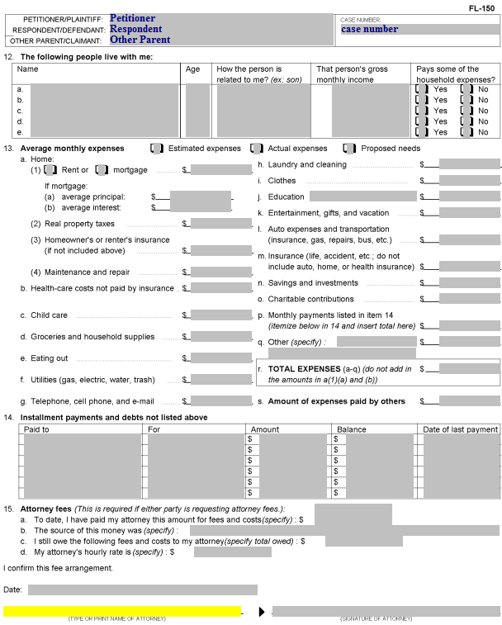
Income and Expense Declaration (page 3)
Item 12. People living with you:
Don’t include yourself.
Don’t include “roommates” (and don’t include their portion of the expenses).
Include the name(s), age(s), relationship to you, income (if known – otherwise “unknown”) and whether the person contributes to household expenses.
Distinguish between biological children and stepchildren.

Slide 35
Income and Expense Declaration (page 3)
Item 13. Check whether the expenses you are describing are Estimated, Actual or Proposed.
In most cases, check “estimated” unless you have proof of your “actual” expenses.
You can use “Proposed” expenses if you want to show what you will need in the future (e.g., you need to move out with a child).

Slide 36
Income and Expense Declaration (page 3)
Item 13.1. Home:
Item 13.a.(1) Check whether you rent or are paying a mortgage, and put the amount you pay each month.
If you know your average principal and interest on your mortgage, enter this information.
Do not include the average principal and average interest in the Total Expenses (13.r.)

Slide 37
Income and Expense Declaration (page 3)
Item 13.a(2) Enter your real property taxes if they are separate from your mortgage payment.

Slide 38
Income and Expense Declaration (page 3)
Item 13.a(3) Enter your homeowner’s insurance (if not included in the mortgage payment) or renter’s insurance.

Slide 39
Income and Expense Declaration (page 3)
Item 13.a(4) Enter the monthly average you pay for maintenance and repairs on your home.

Slide 40
Income and Expense Declaration (page 3)
Item 13.b. Enter your health care costs NOT covered by health insurance
This would include out-of-pocket costs for Doctor visits, emergency room visits, co-pays, prescription costs, etc.

Slide 41
Income and Expense Declaration (page 3)
Item 13.c. Enter the costs paid by you for child care for children in your household. Do not enter child care paid by you to the other parent as part of a court order in this case.

Slide 42
Income and Expense Declaration (page 3)
Item 13.d. Enter your average monthly costs for groceries and household supplies (what you would buy at the supermarket and/or drug store).

Slide 43
Income and Expense Declaration (page 3)
Item 13.e. Enter your average monthly cost for eating out. This includes taking the family out to dinner as well as your costs for lunches (if you go somewhere for lunch during your lunch break).

Slide 44
Income and Expense Declaration (page 3)
Item 13.f. Enter your average monthly utility (gas, electric, water/sewer, trash) costs. (Gas is for home gas service, not gasoline for your car).

Slide 45
Income and Expense Declaration (page 3)
Item 13.g. Enter your average monthly costs for telephone, cell phone, and e-mail (i.e., internet/cable)

Slide 46
Income and Expense Declaration (page 3)
Item 13.h. Enter your costs for laundry and cleaning.
This would include costs of doing your laundry at a Laundromat, or the costs of taking clothes to the cleaners/dry cleaners.
If you do your laundry at home, the cost of laundry soap, etc. should be included in the “Groceries and household supplies” line item (13.d).

Slide 47
Income and Expense Declaration (page 3)
Item 13.i. Enter your average monthly cost for clothes, for you and your household members.
If there are school-age children, don’t forget to include the amounts you spend for “back-to-school” clothes. Take the amount you spend annually and divide it by 12.

Slide 48
Income and Expense Declaration (page 3)
Item 13.j. Enter your average monthly cost for education.
This could be education costs for you or any member of your household, including children/stepchildren.

Slide 49
Income and Expense Declaration (page 3)
Item 13.k. Enter your monthly costs for entertainment, gifts, and vacations.
You can include birthday gifts, outings with children, and other items here. (Divide the annual cost by 12 for an average monthly amount)

Slide 50
Income and Expense Declaration (page 3)
Item 13.l. Enter your average monthly cost for car insurance, gas and repairs, or your bus or other transportation costs.
Your monthly car payment should NOT be included here (it will go in item 14).

Slide 51
Income and Expense Declaration (page 3)
Item 13.m. Enter the cost of your life or accident insurance.
Your home, automobile, or health insurance is included in other items, not here.

Slide 52
Income and Expense Declaration (page 3)
Item 13.n. If you make regular contributions to savings/investments, enter the average monthly amount.

Slide 53
Income and Expense Declaration (page 3)
Item 13.o. Enter your average monthly amount for charitable contributions (e.g., church offering).
Remember, if you make a weekly contribution, multiply the weekly amount by 52 and then divide by 12 (there are more than 4 weeks in some months).

Slide 54
Income and Expense Declaration (page 3)
Item 13.p. Enter the sum of the “Amount” column in Item 14 here.

Slide 55
Income and Expense Declaration (page 3)
Item 14. You will enter information about any monthly installment payments you are making here.
This would include your car payment, loans on which you are making monthly payments (e.g., personal loans, student loans), credit cards, or store accounts.
If you have more items than will fit in the space provided, attach an additional page labeled “Item 14” and provide the same information for each additional item.

Slide 56
Income and Expense Declaration (page 3)
Here you list who you make your monthly payment to.

Slide 57
Income and Expense Declaration (page 3)
Here you list what the payment is for (e.g., auto loan, personal loan, credit card)

Slide 58
Income and Expense Declaration (page 3)
Here you list the amount you pay each month.

Slide 59
Income and Expense Declaration (page 3)
Here you list the remaining balance you owe.

Slide 60
Income and Expense Declaration (page 3)
Here you list the date you made your last payment. You can only include items for which you are current in payments in the total of monthly payments.

Slide 61
Income and Expense Declaration (page 3)
Again, the total of the “Amount” column in item 14 goes here.

Slide 62
Income and Expense Declaration (page 3)
Item 13.q. Enter any other expenses not yet included here.

Slide 63
Income and Expense Declaration (page 3)
Item 13.r. Enter the total of items 1-q here.

Slide 64
Income and Expense Declaration (page 3)
Item 13.s. If someone else is paying part of your expenses, enter the amount they pay here.

Slide 65
Income and Expense Declaration (page 3)
Item 15. Unless you have an attorney, this section should be left blank, and you should not sign it (your attorney would).

Slide 66
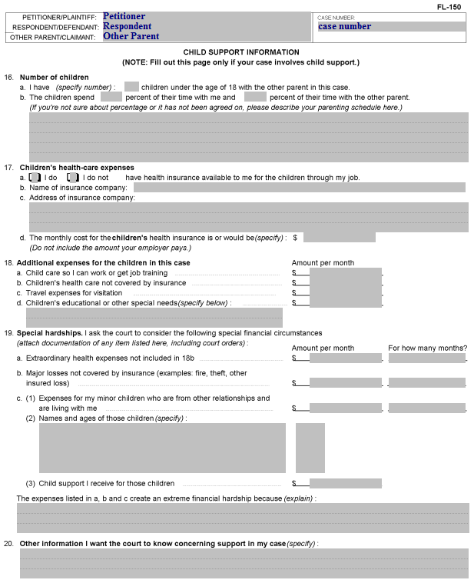
Income and Expense Declaration (page 4)
Item 16.a. Enter the number of children under the age of 18 with the other parent in the case here.
If the child is 18 but has not graduated from high school, include the child and make a note in the space provided for description.

Slide 67
Income and Expense Declaration (page 4)
Item 16.b. Enter the percentage of time the child(ren) spend with you and the percentage of time the child(ren) spend with the other parent.
If you have a weekly visitation schedule, you can determine the percentage by adding the hours of visitation and then dividing the total by 168 (there are 168 hours in a week).
For an alternate weekend schedule, you would divide the hours for the alternate weekend schedule by 336 (the number of hours in two weeks).
Note: Enter the actual current timeshare percentage if it differs from the visitation specified in a court order (e.g., if the non-custodial parent is not exercising his or her visitation rights).

Slide 68
Income and Expense Declaration (page 4)
If you are unable to determine the percentage of the timeshare between the parents, describe the current visitation schedule here.

Slide 69
Income and Expense Declaration (page 4)
Item 17.a. Check the box for whether you do or do not have health insurance available to you for the children through your job.
Item 17.b. If you checked the “I do” box, enter the name of the insurance company.
Item 17.c. Enter the address of the insurance company.
Item 17.d. Enter the cost for the children’s health insurance. Do not include the cost to cover yourself and/or your spouse. Sometimes the employer will cover the employee, but the employee will be required to pay the additional cost of insuring the employee’s children.

Slide 70
Income and Expense Declaration (page 4)
Item 18.a. Enter the amount you pay for child care so you can work or get job training OR, if you are providing proposed expenses, the amount you will be required to pay.

Slide 71
Income and Expense Declaration (page 4)
Item 18.b. Enter the amount you pay for the child(ren)’s health care costs not covered by insurance (e.g., orthodontist’s cost for braces).

Slide 72
Income and Expense Declaration (page 4)
Item 18.c. Enter your costs for travel expenses for visitation; would not include mileage for short drives, but would include expenses for long-distance visitation.
For example, if you pay for two round-trip tickets each year for your child to visit you (or the other parent), and the total cost of the tickets is $1,200, you would enter $100 here (the total divided by 12 to provide the average monthly cost).

Slide 73
Income and Expense Declaration (page 4)
Item 18. Enter the average monthly amount for the child(ren)’s educational or other special needs costs here.
This may include tuition, books, adaptive devices, etc.
Describe the expenses in the space provided. If you need additional space, attach a page labeled “Item 18.”

Slide 74
Income and Expense Declaration (page 4)
Item 19. This section is for special hardships you want the court to consider.
Item 19.a. Enter any extraordinary expenses not included in 18.b. here.
For example, if there was a necessary emergency room visit that resulted in hospitalization of the child, you may have a bill of thousands of dollars. Enter the amount you are paying each month in the first (Amount per month) column, then enter the number of months it will take you to pay off the bill in the second (For how many months?) column.

Slide 75
Income and Expense Declaration (page 4)
Item 19. This section is for special hardships you want the court to consider.
Item 19.b. Enter the amount per month you are paying on major losses not covered by insurance, and the number of months it will take you to pay off the loss.

Slide 76
Income and Expense Declaration (page 4)
Item 19. This section is for special hardships you want the court to consider.
Item 19.c.(1) Enter the monthly amount you spend for support of biological children (not stepchildren) who are living with you, and the number of months they will be living with you (if it is a permanent living situation, you can enter “ongoing” in the second column.

Slide 77
Income and Expense Declaration (page 4)
Item 19. This section is for special hardships you want the court to consider.
Item 19.c.(2) Enter the names and ages of minor biological children (not included in this case) living with you here.

Slide 78
Income and Expense Declaration (page 4)
Item 19. This section is for special hardships you want the court to consider.
Item 19.c.(3) If you receive child support for the child(ren), enter the amount you receive here.

Slide 79
Income and Expense Declaration (page 4)
Describe why the expenses in this section create a financial hardship for you here.

Slide 80
Income and Expense Declaration (page 4)
Item 20. Enter any other information you think the judge should know about your child support here.

