Slide 1

Court Connected Child Custody Mediation

Slide 2
Introduction to Mediation
Mediation is required whenever there is a dispute about child custody or visitation
Mediation focuses on developing an agreement between parents that is in the best interest of the children
Family Code §3170

Slide 3

California Law Defines
Three Purposes of Mediation
To reduce conflict between the parents
To develop an agreement ensuring the child’s close and continuing contact with both parents
To reach a settlement regarding visitation rights that is in the best interest of the child
Family Code §3161

Slide 4

Mediation Assists Both Parents to Reach an Agreement
Mediation is provided at no cost to parents
Specially trained mediators will help parents work out the terms of a parenting plan
Your parenting plan may consist of:
  How time will be shared during the school year and summer
  Holiday and vacation schedules
  Transportation and exchanges
  How safety issues may be addressed
  Other important details specific to your situation

Slide 5
What if Parents Already Have an Agreement?
To make your plan a court order, you must provide a written agreement to the court for approval.
  If either party has an attorney, the attorney may assist in presenting the agreement to the Court.
Participation in court ordered mediation will allow a professional to review the agreement, assure all parenting plan aspects are included and prepare the agreement for filing or hearing.

Slide 6
The Mediation Process

Slide 7

Mediation Goals
Help you reach an agreement that is in the best interest of the children
Reduce conflict between the parents
Enhance understanding of the other parent’s point of view
Focus on what works best for your children
Work out the details of your parenting plan

Slide 8

What is NOT Discussed in Mediation?
Child support
Spousal support
Property and other monetary disputes

Slide 9

What may be in a
Parenting Plan?
Legal and physical custody
Regular schedule of when the child(ren) will be with each parent
School year schedule
Summer schedule
Holidays and birthdays
Vacations
Transportation and exchanges
Phone calls; communication guidelines
Extra-curricular activities
Guidelines for addressing safety concerns

Slide 10

Parenting Plan Considerations
Age and emotional stage of development of each child
Frequency of contact and involvement with both parents
Distance between parents’ residences
Your child’s special needs, school events, sports schedules or other extracurricular activities
Safety concerns and level of parental conflict

Slide 11

Legal Custody
Legal custody includes the right to make decisions about a child’s residence, health, education, and welfare
Legal custody is either joint or sole
  Joint legal custody = parents make decisions together
  Sole legal custody = one parent has the exclusive right to make decisions
Family Code Sections 3003 and 3006

Slide 12
Physical Custody
Physical custody is either joint or sole
  Joint physical custody =
    Both parents share significant periods of physical custody that assures frequent and continuing contact with both parents
    Does not necessarily mean equal time share
    One parent may still be designated as the primary caregiver.
  Sole physical custody =
    One parent provides primary residence and supervision of the child
    The other parent may have court ordered visitation
Family Code Sections 3004 and 3007

Slide 13
Custody Considerations When There is Domestic Violence
If the Court has made findings of domestic violence by a parent, the court will determine legal and physical custody of the children
Mediation may assist with developing a safe visitation plan which may include monitored contact and third party exchanges
Family Code 3044

Slide 14

Special Mediation Rules when there is Domestic Violence
Restraining Orders are to be followed at all times
A separate waiting room is available for each party
The mediator will meet with the parents separately (California Rule of Court 5.215(d)(6))
A support person may be present during the mediation session (Family Code 6303)

Slide 15

Mediation in Orange County is a Confidential Model
If no agreement is reached:
  The matter will be referred back to court for the Judicial Officer to make a decision regarding custody and visitation
  The mediator will not discuss what happened during your sessions with anyone
  The mediator will not make a recommendation to the Judicial Officer regarding a parenting plan
Mediators do not:
  Give legal advice
  Discuss child support, spousal support, or division of property

Slide 16

Mediation Confidentiality Exceptions
  Mediators are required by law to report to the local child protection or law enforcement agency the following:
    Abuse or neglect
    A person’s intent to harm themselves or others
Mediators may not be able to mediate if there is an open child protective services case involving the same children

Slide 17

Who Are Your Mediators?
Family Court Services mediators have a masters degree (or higher) in a behavioral science such as psychology, social work, marriage and family, or child counseling
Mediators have a minimum of two years post master’s experience, knowledge of child development, the court system and community resources (Family Code 1815)
In addition, court connected mediators are required to complete 8 hours of continuing education (CRC 5.210(f)(1)(B)) and 4 hours of domestic violence training annually (CRC 5.215(j)(2))

Slide 18

Mediation Process
The participants only include the legal parents and the mediator
Each parent presents their proposals for child sharing and custody
  The parent who filed the current request for court orders generally speaks first.
  If both parents filed at the same time, the mediator will ask the parents if they have a preference of who speaks first.
Parents negotiate and compromise to reach an agreement
The mediator
  Remains impartial
  Does not take sides
  Provides education and suggestions to assist parents with their parenting plan

Slide 19
Mediation Guidelines
Do
  Focus on child’s best interest
  Come with an open mind
  Prepare to discuss several possible options
  Remember children do best with involvement from both parents
Don’t
  Focus on or blame the other parent
  Reject a proposal without consideration
  Let emotions and past history guide decisions

Slide 20
Mediation Outcomes
Agreement Reached
    The agreement is reviewed with both parents and forwarded to Judicial Officer for approval
Partial Agreement
  Agreed upon terms
    Reviewed and forwarded to the Judicial Officer for approval
  Remaining issues
    Further mediation or
    Returned to court for decision

Slide 21
When there is no agreement…
Choices to assist parents may include:
  Further mediation
  Interview child
  Mediators may speak with parents’ attorney
  Refer back to court
If there are safety concerns the Mediator may suggest to the Judicial Officer:
  Attorney appointed for the child
  Child Custody Investigation
  Psychological Evaluation (California evidence code 730)

Slide 22

Children in Mediation
Mediators will use their discretion in deciding if it is necessary to interview your children (Family Code 3180)
Mediators are trained to work sensitively in these matters
Children are not asked to choose sides or to choose between parents

Slide 23
Emotional Issues

Slide 24

Children Love Both of Their Parents Equally
It isn’t their job to choose
It is your job to decide

Slide 25

Emotional Justice
If you are here to right an emotional wrong, Family Court is not the place
Mediation is not about winning or losing – it’s about problem solving for the best interest of your children
Consider counseling and/or join a support group to help you

Slide 26
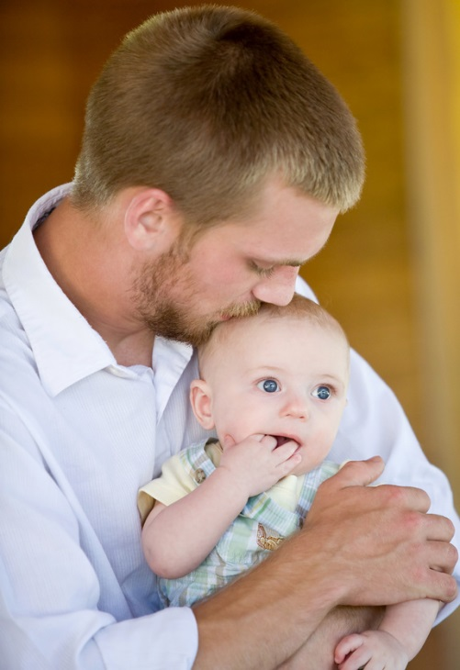
You Stop Being Partners but...
You continue as parents
Separate your feelings about the other parent from your child’s needs
Involvement by both parents with child’s activities is crucial to their healthy development

Slide 27

Research Findings
Children:
Need to be emotionally and physically safe from parental conflict
Need a relationship with both parents
Who witness family violence of any kind are emotionally distressed

Slide 28

Research Findings, cont.
Children:
Need consistency and regular contact with both parents, not necessarily equal time
Do better when they know when they will be spending time with each parent
Experience a great sense of loss during separation and/or divorce
Need emotional support and guidance through the process

Slide 29
Psychological Tasks for
Children in Separation
Based on Judith Wallerstein’s book Second Chances
Acknowledge the reality of the separation and loss
Disengage from the parental conflict
Resolve anger and blame
Achieve realistic hope about relationships
Accept the permanence of the separation

Slide 30

Stages of Grief and Loss
Through Separation
Stages | For Adults | For Children
Denial | This can’t be happening. She or he will come back and we will work it out. | Mom and Dad can’t be hurting me and each other. It’s only temporary. They will get back together.
Anger | How could she or he do this to me? I’m the responsible one. He or she is not the person I knew. | How could they do this to me? If they loved me, they would stay together.
Bargaining | If we get counseling or I change, then we’ll get back together. | If I am really good, maybe they will get back together.

Slide 31
Stages of Grief and Loss
Through Separation, cont.
Stages | For Adults | For Children
Depression | I’m overwhelmed. I can’t cope. It’s all too much. No one understands. | It’s my fault. I hate school. I hate my life. Nothing is okay.
Acceptance | It’s over. I need to get on with my life and career and help our kids get their lives back to normal. | Mom and Dad are not getting back together and it’s okay.
Growth | I’ve moved on. I know myself better. I’m ready for something new. | I don’t have to pretend anymore.

Slide 32
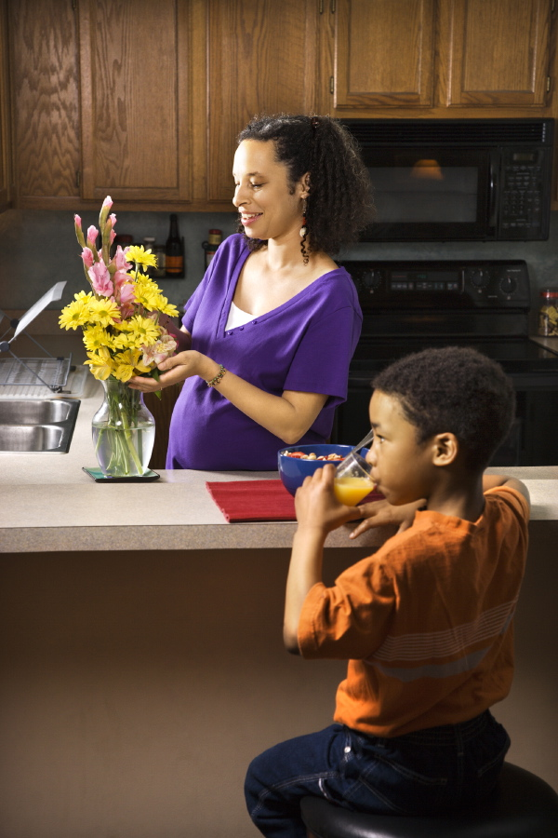
Supporting Your Children
Support the time the child is with their other parent
Promptly share child related information
Tell your children they are not the cause of the separation
Remind your children both parents will always love them and take care of them

Slide 33

Supporting Your Children, cont.
Give your child permission to love both parents and their loved ones
Enjoy and admire your children
Give your child permission to have a positive relationship if there is a new significant other
Don’t use time with the other parent as a reward or punishment for good or poor behavior

Slide 34
How to Respond to Your Child’s Questions
Acknowledge the child’s feelings
Be reassuring
Don’t give too much detail
Provide age appropriate information
Consider professional help if needed

Slide 35
Parenting Together

Slide 36

Understanding Co-parenting
Recognize differences and respect the other parent’s parenting style
Children do adjust and adapt to two separate homes with separate rules & expectations
The 3 “C’s” of Co-Parenting:
  Communication
  Collaboration
  Coordination

Slide 37

Communication is the Key to Successful Co-parenting
Maintain focus on children
Share information regarding child’s activities
Avoid conflict while children are in earshot
Timeouts when conversation is tense
Listen

Slide 38


Co-parenting Tips
Be respectful of each parents’ role in your child’s emotional development
Respect each other’s point of view
Maintain flexibility for child’s needs, Vacations, Special Events, Illness
Be consistent in the routine between both homes as much as possible
  Bedtime, Nutrition, Hygiene, Homework, TV & Computer, Discipline

Slide 39

Problems You Can Avoid
Using your child as a pawn, messenger, spy, or bargaining chip
Criticizing the other parent in front of the child
Making your child take sides
Withholding your love when you are angry with the other parent

Slide 40

More Problems to Avoid
Withholding visits
Arguing in front of your child
Speaking negatively about the other parent or their loved ones
Focusing on the small stuff, remember the bigger picture
Excluding the children from their extended family members, including half- and step-siblings and grandparents

Slide 41

Important Reminders
It is a difficult time for both children and parents
Your behavior will impact your child’s ability to experience healthy future relationships
Children will need your support
Children experience conflicting feelings, often expressed differently to each parent
Parenting continues beyond your child’s 18th birthday

Slide 42

More Reminders
  Children do best when parents get along
  Put aside your differences for your children’s sake
  Come to mediation with an open mind

Slide 43

Your Children = Your Decision
  Parents who make their own mutual decisions regarding their Parenting Plan are less likely to need future court involvement and are generally happier with the outcome

Slide 44

Frequently Asked Questions
How do I get my mediation appointment? | Appointments are initially set by the Family Law clerk at the time one parent files a Request for Order (RFO) for custody or for a modification of an existing court order. An Order with the date and time of your mediation appointment will be included in the RFO. Parents may also be referred to mediation by the Judicial officer
When are appointments? | Scheduled Monday-Friday, between the hours of 8:00 am and 3:00 pm. Plan to be at your appointment for at least two hours.
What if someone does not attend mediation? | Notice of a failure to appear will be provided to the Judicial officer for the hearing. A monetary sanction of $100.00 may also be imposed. Failure to attend your mediation appointment may cause your court hearing to be rescheduled, delaying the opportunity for the judicial officer to make any decisions regarding custody and time with your children.
What if someone is late? | Mediation cannot start until both parties arrive. A late arrival of 30 minutes may result in the appointment being cancelled and notice provided to the Judicial officer.

Slide 45

Frequently Asked Questions, cont.
How much does it cost? | There is NO cost for mediation.
Can I reschedule? | Only in an emergency. Call 657-622-6196 to reschedule your appointment at least 72 hours in advance.
Who should attend? | Both parents attend together. Do not bring children or significant others.
Where is mediation held? | On the 5th floor in the Lamoreaux Justice Center, Family Court Services Office, Room 507 341 The City Dr. Orange, CA 92863

